Slide 1
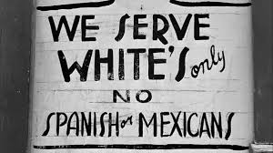
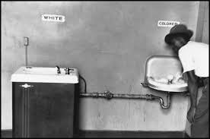
Jim Crow Laws
Jim Crow laws passed to separate blacks and whites; legal basis for segregation (separation of people based on race)
Jim Crow laws blocked educational, economic, and social growth and opportunities for most Southerners, both black and white.
Segregation included (but not limited to)
Schools
Public transportation
Water fountains and bathrooms
Graveyards and bibles used to swear on it court

Slide 2
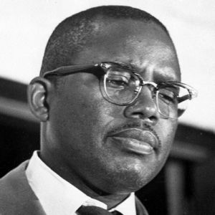
Jim Crow
“We were segregated from the cradle to the grave, the toilet to the train, the classroom to the courtroom.”
Fred Gray
(Civil Rights Activist and lawyer for Rosa Parks)
Inter-racial marriage between the races was strictly forbidden
Lynching was used in largely rural areas to enforce the social order of segregation
From 1882-1930, 482 African-Americans were lynched in Georgia, second only to Mississippi.

Slide 3
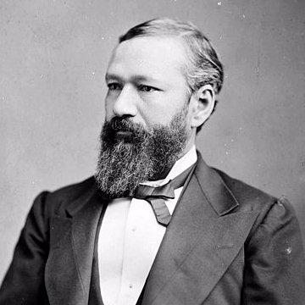
Plessy VS Ferguson
SEPARATE BUT EQUAL…
June 7, 1892 – Louisiana
Homer Plessy was arrested for sitting in the “Whites Only” section of a railcar
It was a planned protest
He was 1/8th black and “could pass for white”
Identified himself as a black man
Wanted to challenge Louisiana’s segregation laws

Slide 4
Plessy VS Ferguson
SEPARATE BUT EQUAL…
Went to the Supreme Court
Court ruled AGAINST Plessy
“Separate but equal”
14th and 15th amendment gave African Americans POLITICAL rights, not social rights
As long as the facilities were equal, they could be separate
………………………………..but were they?

Slide 6
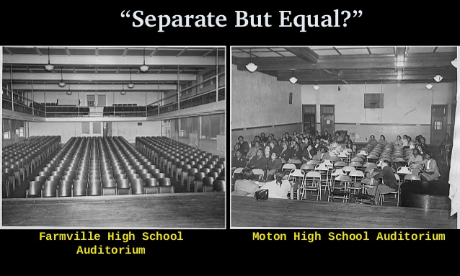

Slide 7
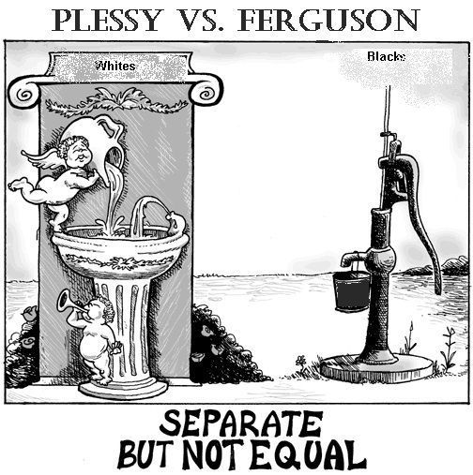

Slide 8
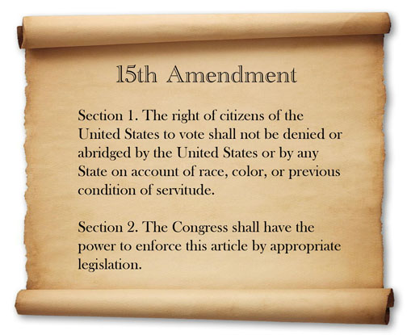
Disenfranchisement
Denying the right to vote
Different ways of preventing certain people from voting

Slide 9
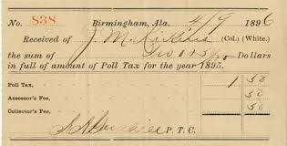
Disenfranchisement
Fee at the voting booth for African Americans and poor whites?
This tax was waived for most poor whites.

Slide 10
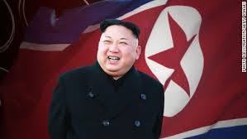
Disenfranchisement
Grandfather Clause
You can vote if your father could vote, or your Grandfather fought in the Civil War
This allowed all whites to vote, but ruled out AA
Let whites bypass poll taxes and literacy tests.

Slide 11
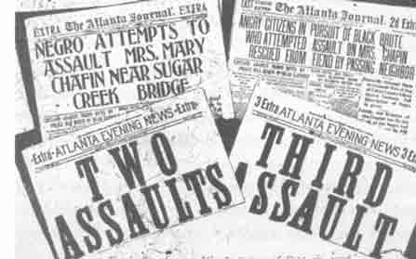
1906 Atlanta Riot
Racial Violence spreading through out the South
Sept 22-24 Riot
Lasted 48 hours
Caused by local newspaper articles claiming black men were attacking white women
Untrue
Whites were threatened by blacks taking their jobs

Slide 12
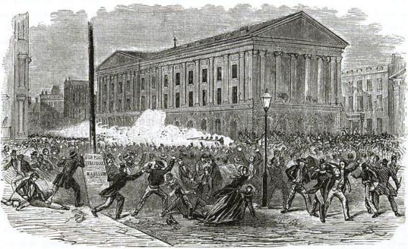
Atlanta Riots
Group of white men gathered in Atlanta wanting revenge for the attacks on women (not knowing they were untrue)
Officials were trying to calm the mob
They started attacking any black men they saw

Slide 13
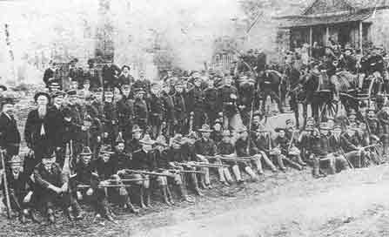
Atlanta Riots
They started entering black businesses and beating people to death
Georgia militia was called in
Blacks then armed themselves in defense
Continued on the next day

Slide 14
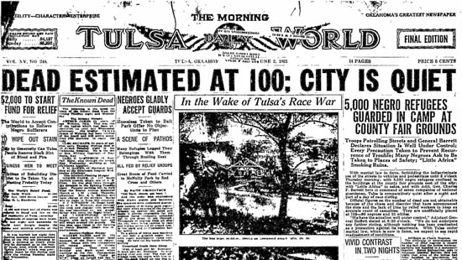
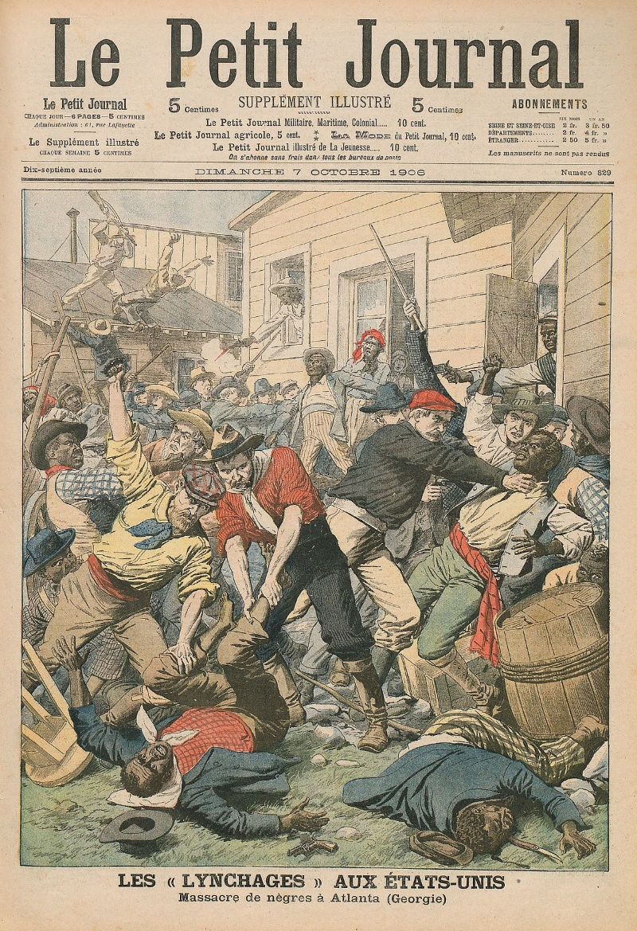
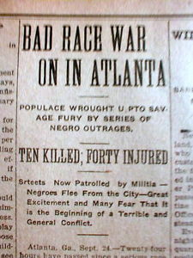
Atlanta Riots
Black and white businessmen came together to end the riot
They did not like the negative attention Atlanta received
Effect: deeper segregation until 1960s (civil rights)

Slide 15
Bourbon Triumvirate
GA’s 3 most powerful politicians post-reconstruction
Experience during Civil War helped them earn their status
Focused on Agriculture in the beginning and then transitioned into businesses and industry
Interested in railroad and coal-mining
Supported white supremacy
Never again has a trio dominated politics in Georgia

Slide 16
Henry Grady
Journalist
Called post-reconstruction “New South”
Full of industrialization and economic success
Influential in politics
“Spokesman of the New South”
Cotton Expositions
Brought in millions of $
Created Thousands of jobs
Claimed everyone was treated fairly in Atlanta

Slide 17
Tom Watson
Populist Party supporter
Pro-agriculture
Condemned lynching
Elected to GA House of Representatives
Spoke out about growing racism in the South
Against US in WWI
Elected to Congress
(1904-became aggressive white supremist/anti-jews, catholics, AAs)

Slide 18
Booker T Washington
Educator, power broker, institution builder
Founded Tuskagee Insitute (Black University)
Created schools, newspapers, and National Negro Business League
Focus on Economic Self-determination not political and civil rights
Helped form the NAACP and secretly worked against Jim Crow Laws and spoke out against lynching

Slide 19
W.E.B. DuBois
Activist
Writer and fonder of NAACP
National association for advancement of colored people
Wanted to change Jim Crow Laws
Harvard University (PhD)
Believed African Americans should be fully equal in every way
Advocated for women’s rights as well

Slide 20
Alonzo Herndon
Owned a barber shops in Atlanta
Gold and chandeliers
Invested in Real Estate
Bought a burial company that turned into Atlant Life Insurance Company
1 of the most successful black owned businesses in the country
First African American Millionaire in Atlanta
Entrepreneur; owned more property than any other African American

Slide 21
Leo Frank (Jewish)
Last person to see Mary Phagan alive
One of many suspects in Mary’s murder
Sentenced to life in prison for the murder he didn’t commit
A mob broke him out of jail and took him to Marietta where they lynched him
The KKK rose once again from the mob that lynched Leo Frank
(Officially pardoned in 1986)
(era of Antisemitism)

