Slide 1
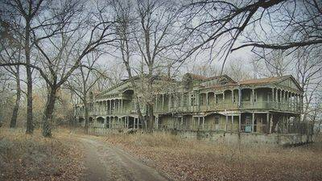
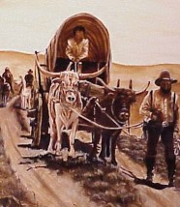
KUDOs
Know
Westward Expansion
Understand
SS8H4 Explain significant factors that affected westward expansion in Georgia between 1789 and 1840
Do
Begin Simulation and OneSheet

Slide 2
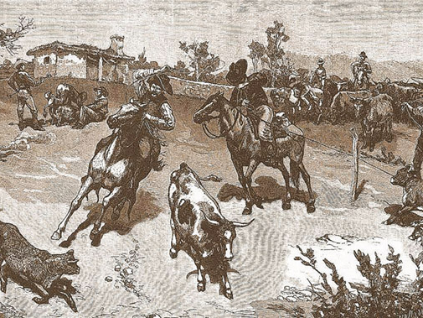
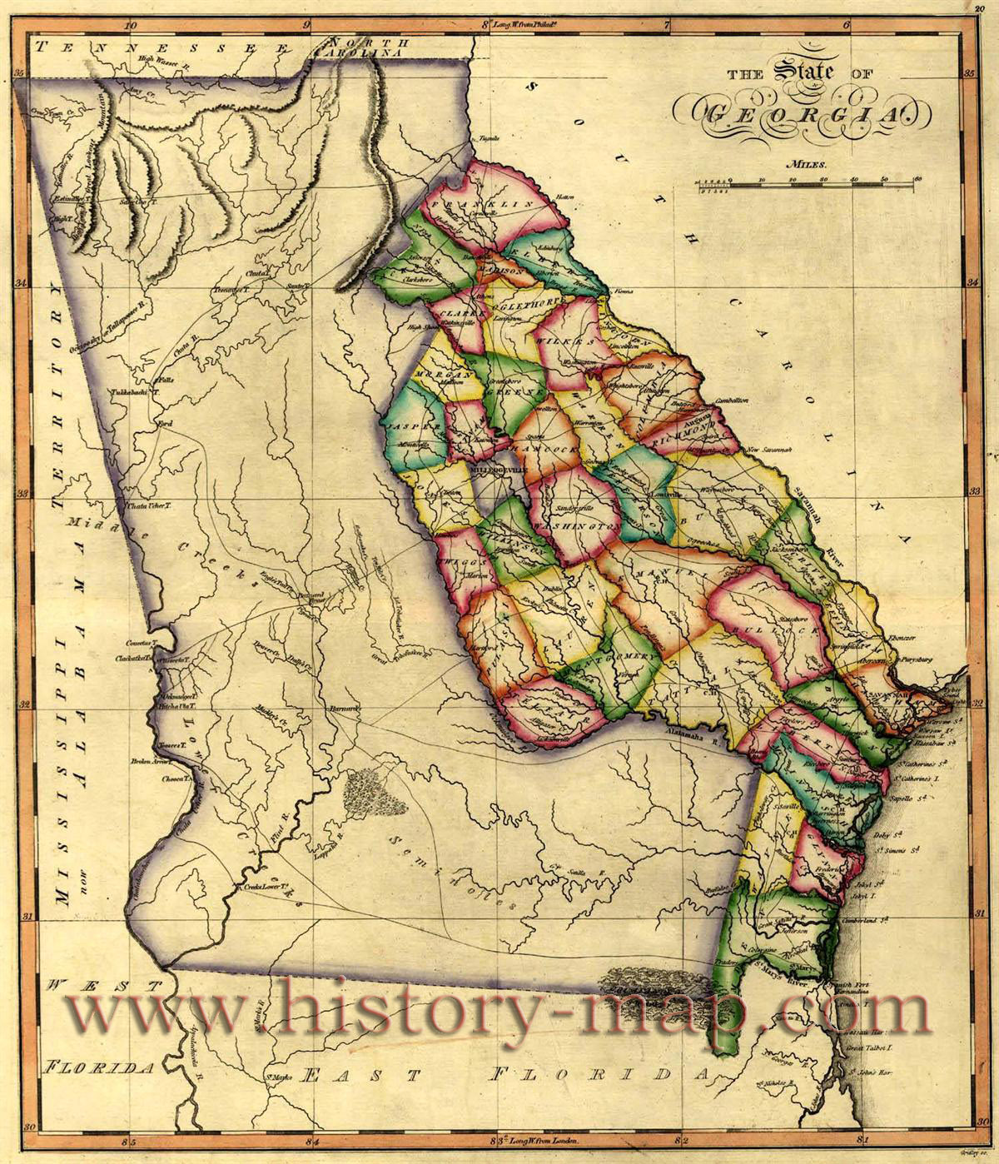
Frontier Georgia
Indian land in central and western Georgia
Headright System
Every white male counted as a head of household and had the “right” to receive up to 1,000 acres
This was replaced in 1803 by a land lottery
Land Lottery
All white men over 21, widows, and orphans could buy a lottery chance and win land; millions of acres in several states were given away

Slide 3
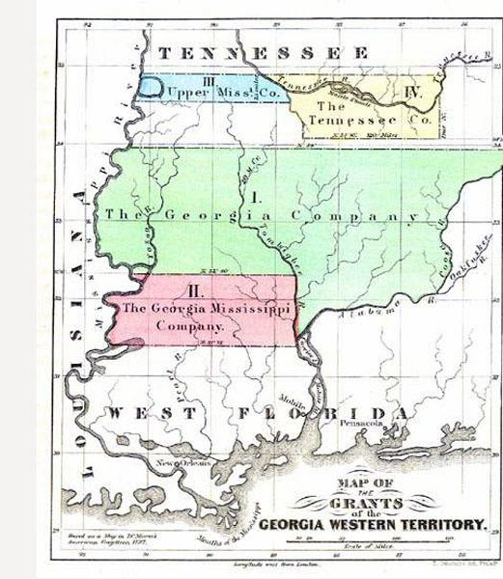
Yazoo Land Fraud
Around 1795, four companies bribed the governor and legislators
Bought millions of acres in western Georgia (today’s Alabama and Mississippi) for 1½¢ an acre
The public found out and protested; the legislators involved were voted out of office
Angry about corruption
Angry b/c that land was supposed to be free under Headright System
The General Assembly (GA’s legislative branch) repealed (canceled) the law approving the sale

Slide 4
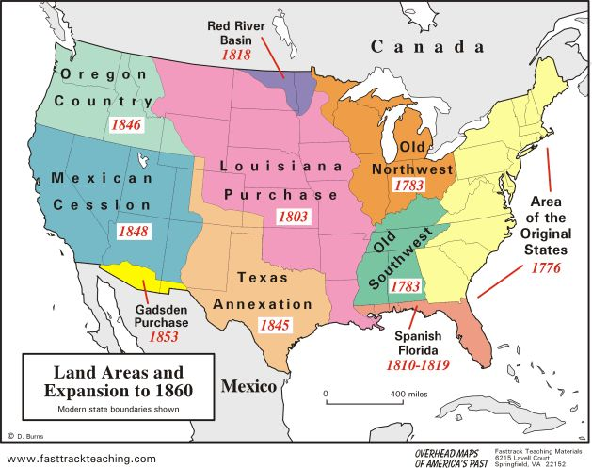
Westward Expansion
President Thomas Jefferson doubled the nation’s size in 1803 with the Louisiana territory purchase; the U.S. paid France $15 million for land that stretched to the Rocky Mountains
3 Cents/ acre (.67 today)
Today = worth $3,000/acre
1804, Lewis and Clark explored this newly purchased territory for 2 years with the aid of Sacagawea, a pregnant female Indian guide.

Slide 5
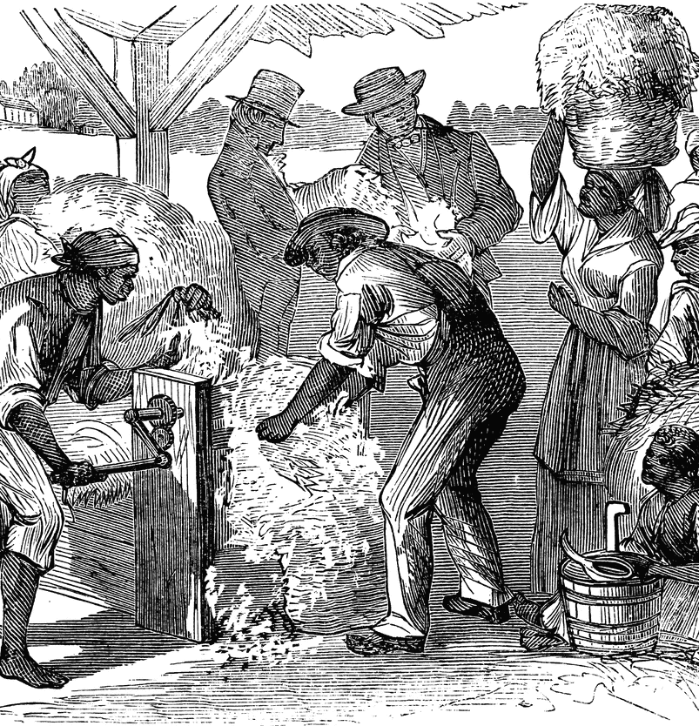
Cotton Gin
Cash Crop – Crops (such as cotton) which are grown to be sold.
Eli Whitney in 1793 invented a machine for separating cotton seeds from its fiber
Increased the amount cotton growers could process each day
Other inventions, such as the Mechanical Reaper also helped farmers to become more productive.
Since farmers were now able to do more work each day, many farmers wanted to move westward so that they could have even larger farms.

Slide 6
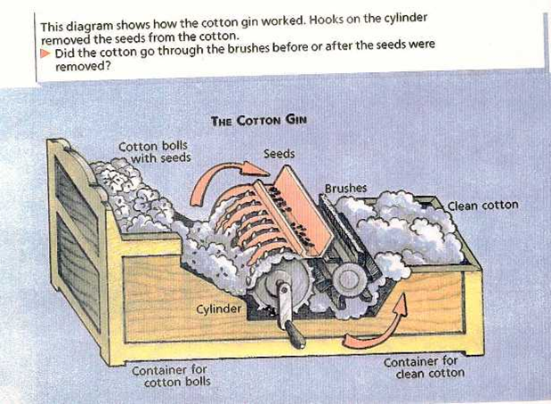
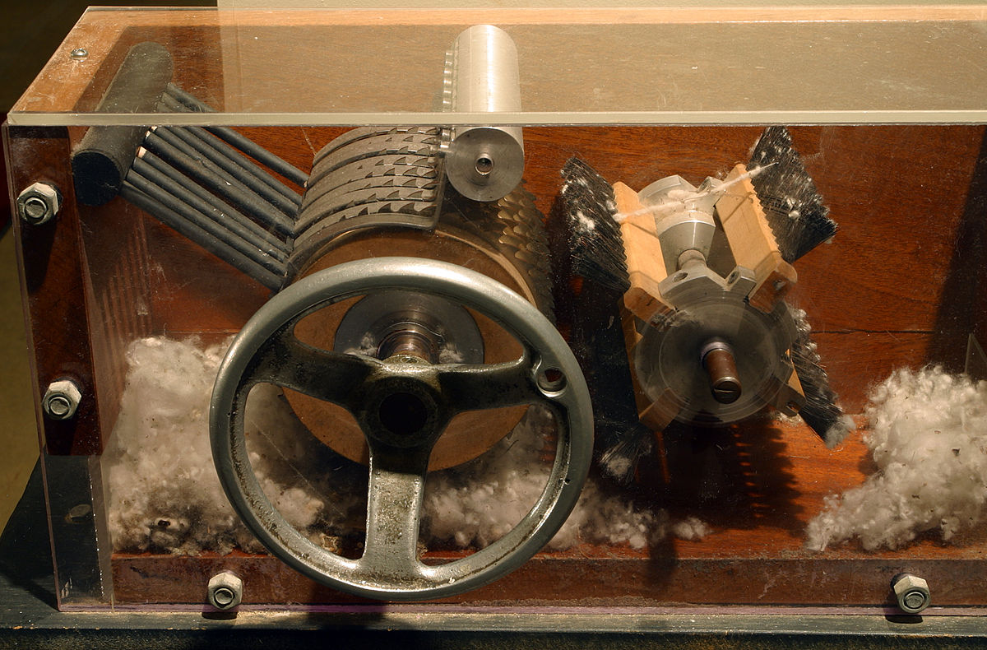

Slide 7
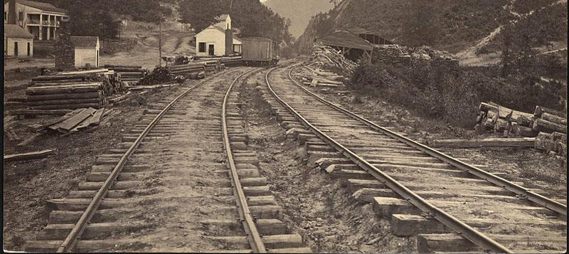
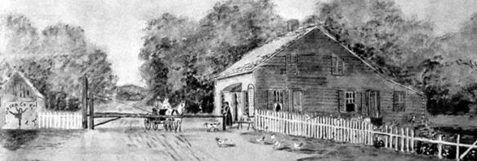
Railroads
Railroads, most built after 1830, replaced horses, stagecoaches, and boats. Railroads helped Georgia’s citizens travel and trade much more efficiently (easier/faster to move people and goods).
Terminus (Atlanta) “End of the line”
No waterways to Atlanta
Road conditions were poor
Businessmen needed a way to move lots of product quickly

Slide 8
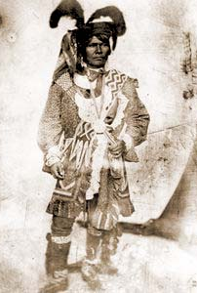
Creek Indians
Wanted to fight to keep their land.
Headright System and Land Lotteries were taking Creek territory that they gave up and handed it to American settlers.
Creeks fought a Civil War amongst themselves.
Andrew Jackson defeated the last of the Creeks, ending the Creek war.

Slide 9
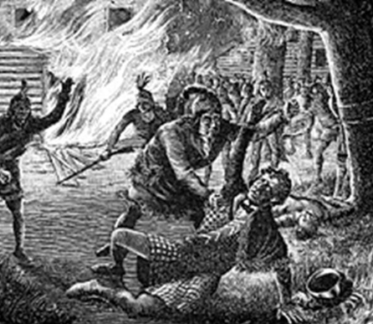
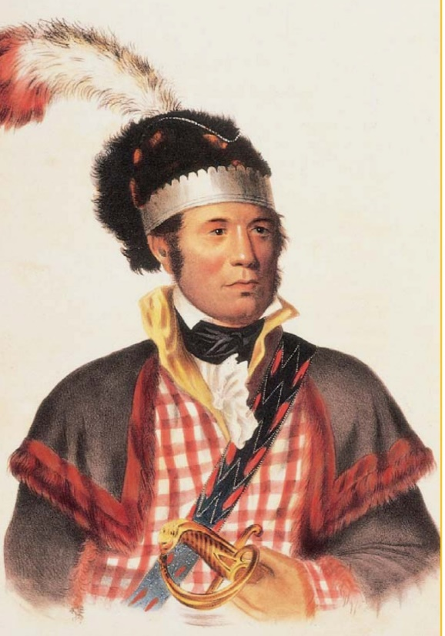
William McIntosh
Creek Chief
Encouraged Creek Indians to adopt the colonist ways to own property, grow cotton, and own slaves.
McIntosh supported Andrew Jackson in the Creek Indian Wars.
On February 12, 1825, Chief William McIntosh secretly sold the last of the Creek lands in Georgia to the U.S. government for $200,000.
Groups of Creek Indians beat, stabbed, & scalped Chief McIntosh for secretly selling away the Creeks’ land to the USA.

Slide 10
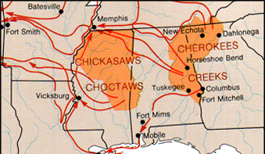
Cherokee Nation
The Cherokee occupied the Northern 1/3rd of Georgia and extended into 3 other states.
They saw the Creek driven from their lands and were determined to be different.

Slide 11
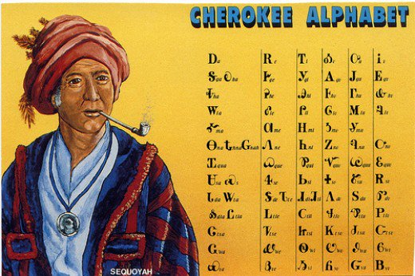
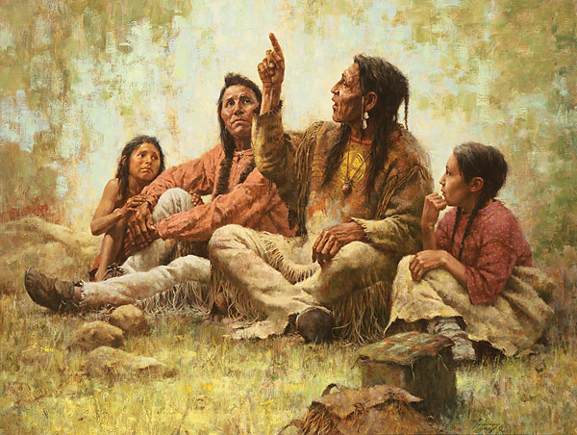
Cherokee Nation
Wished to show that they were “civilized” like Europeans.
Created an advanced society with an independent government, capital city, and a constitution
Sequoyah – developed the Cherokee SYLLABARY.
First native written language.
Used it to create a library.

Slide 12
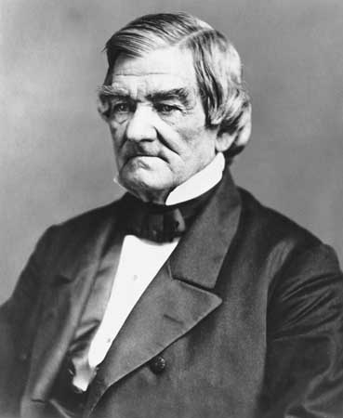
John Ross
Helped create a Cherokee Constitution.
Argued the case for the Cherokee nation before the Supreme Court
Guided the Cherokee through the difficult Trail of Tears march to Oklahoma.

Slide 13
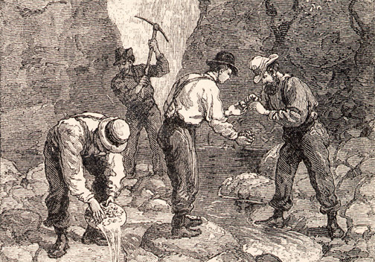
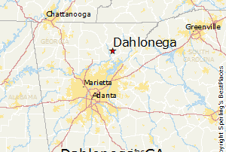
Gold leads to Problems
Gold was discovered on Cherokee lands near Dahlonega, GA in 1829.
Prospectors rushed there ignoring Cherokee territorial rights.

Slide 14
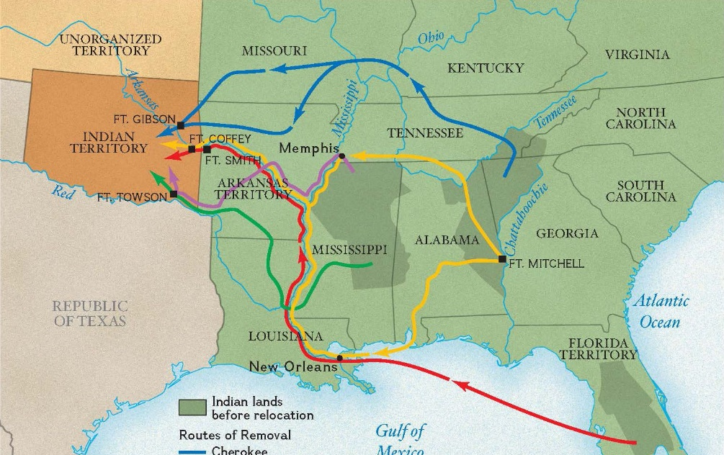
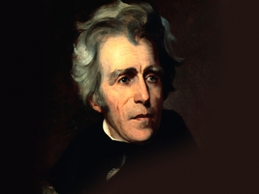
Indian Removal Act
Andrew Jackson elected in 1828
President Andrew Jackson supported Georgia’s interests in removing the Cherokee from their land.
The Indian Removal Act was enacted to remove all Indians from Georgia and settle them on land west of the Mississippi.
Reservations
$500,000 set aside to enforce

Slide 15
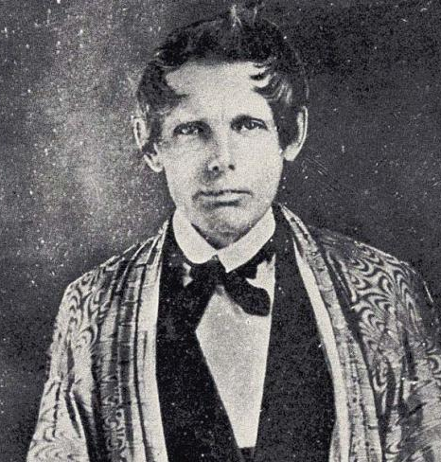
Worcester V Georgia
U.S. Supreme Court case to decide if the Cherokee had the right of sovereignty (self-govern).
Chief Justice John Marshall decided in the Cherokee’s favor.
President Andrew Jackson refused to enforce the ruling and ordered that the Indians be removed.
Georgians ignored the ruling and continued to move into Cherokee lands.

Slide 16
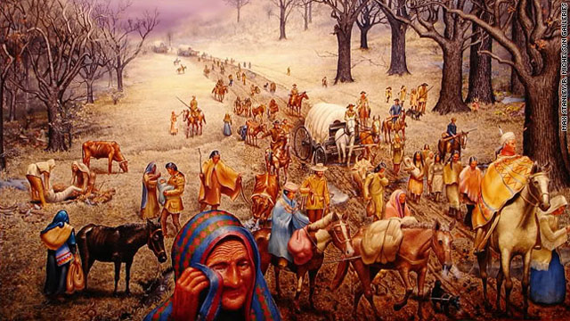
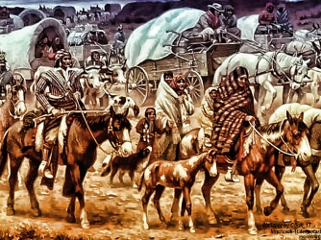
Trail of Tears
John Ross and his people held out until the U.S. sent troops in 1838.
The troops rounded them up and sent them to the Oklahoma Territory. (approx. 14,000 Cherokee)
It was winter during the 800 mile walk.
An estimated 4,000 Cherokee died from harsh weather conditions, disease and lack of food during the six-month trek.

Slide 17
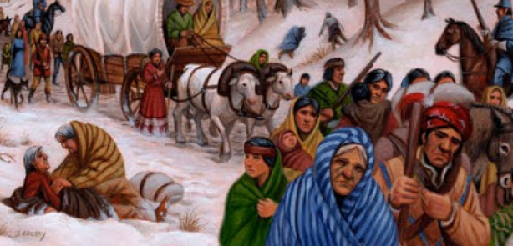

Slide 18
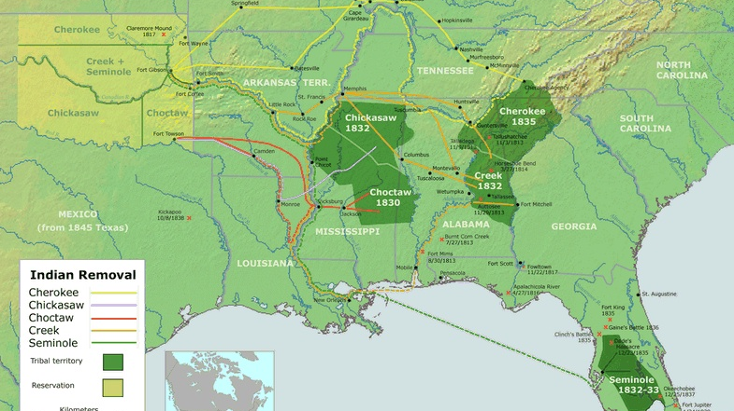

Slide 19
