Slide 1
Do you remember?
Who owns the 13 Colonies?
What makes Kings more powerful?
Which country was good friends with the Indians?
How was France making so much money? (think about where they are located)

Slide 2
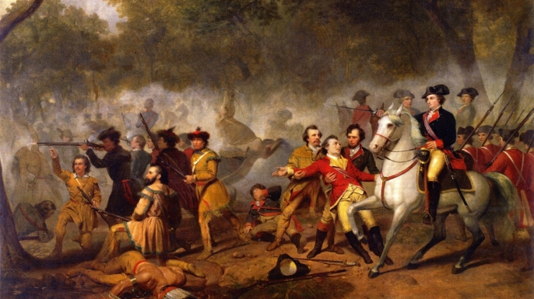
French and Indian War
France and Great Britain wanted the treasures (resources, gold, land, etc.) of the American continent
Both countries feared the other would gain the most power
France had the stronger army with more experienced leadership; British had better navy
France had Indians on their side
England had the colonists helping.

Slide 3
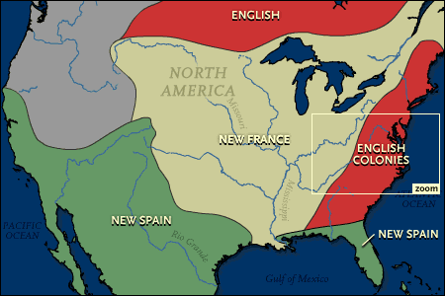

Slide 4
Timeline
1770 Boston Tea Party
Charter of 1732
1742 War of Jenkin’s Ear
1764 Stamp Act
1754 F&I War Starts
Feb 1733 Savannah
1752 GA becomes a Royal Colony
1763 F&I War Ends
1770 Boston Massacre
1775 American Revolution Begins

Slide 5
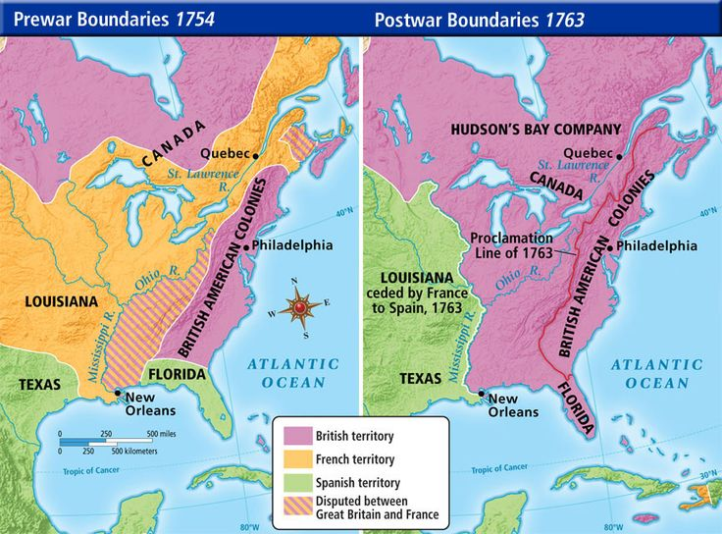

Slide 6
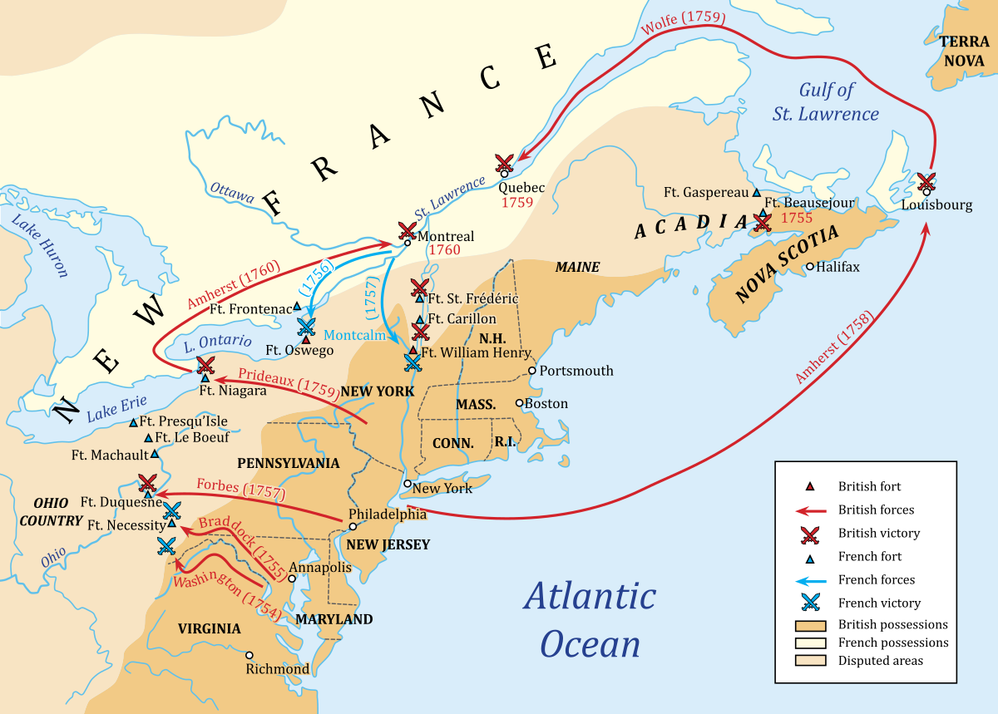
French and Indian War
Both sides claimed the Ohio River Valley area (more than 200,000 square miles)
The French built several forts in the area; many Indians sided with the French
The Virginia governor sent Captain George Washington with soldiers to Fort Necessity (near today’s Pittsburgh); a battle erupted
France was winning,,,

Slide 7
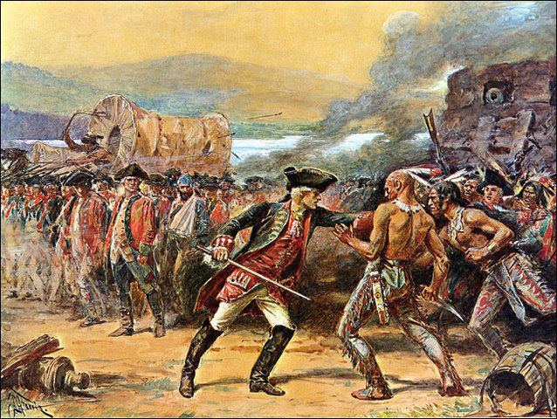
French and Indian War: Aftermath
Treaty of Paris set Georgia’s western boundary at the Mississippi River
Proclamation of 1763 (King George III): Georgia’s southern boundary set at St. Mary’s River; Georgia colonists could not settle west of the Appalachian Mountains as the land was reserved for Native Americans.
Cherokee and Creek tribes gave up land claims north of Augusta and in the coastal region

Slide 9
Exit Ticket: French and Indian War: Aftermath
What is the result of every war in history ever?!
Since Britain helped out the Americans, what do you think they are going to ask?
How is Britain going to get their money?
How do you think the colonists are going to react?

Slide 10
Taxes Checkpoint
Taxes 1700’s
Paper
Sugar
Molasses
Tea
Lead
Glass
imports
Taxes Now:
Accounts Receivable Tax
Building Permit Tax
Capital Gains Tax
CDL license Tax
Cigarette Tax
Corporate Income Tax
Court Fines (indirect taxes)
Dog License Tax
Federal Income Tax
Federal Unemployment Tax (FUTA)
Fishing License Tax
Food License Tax
Fuel permit tax
Gasoline Tax
Hunting License Tax
Inheritance Tax Interest expense (tax on the money)
Inventory tax IRS Interest Charges (tax on top of tax)
IRS Penalties (tax on top of tax)
Liquor Tax
Local Income Tax
Luxury Taxes
Marriage License Tax
Medicare Tax
Property Tax
Real Estate Tax
Septic Permit Tax
Service Charge Taxes
Social Security Tax
Road Usage Taxes (Truckers)
Sales Taxes
Recreational Vehicle Tax
Road Toll Booth Taxes
School Tax
State Income Tax
State Unemployment Tax (SUTA)
Telephone federal excise tax
Telephone federal universal service fee tax
Telephone federal, state, and local surcharge taxes
Telephone minimum usage surcharge tax
Telephone recurring and non-recurring charges tax
Telephone state and local tax
Telephone usage charge tax
Toll Bridge Taxes
Toll Tunnel Taxes
Traffic Fines (indirect taxation)
Trailer registration tax
Utility Taxes
Vehicle License Registration Tax
Vehicle Sales Tax
Watercraft registration Tax
Well Permit Tax
Workers Compensation Tax

Slide 11
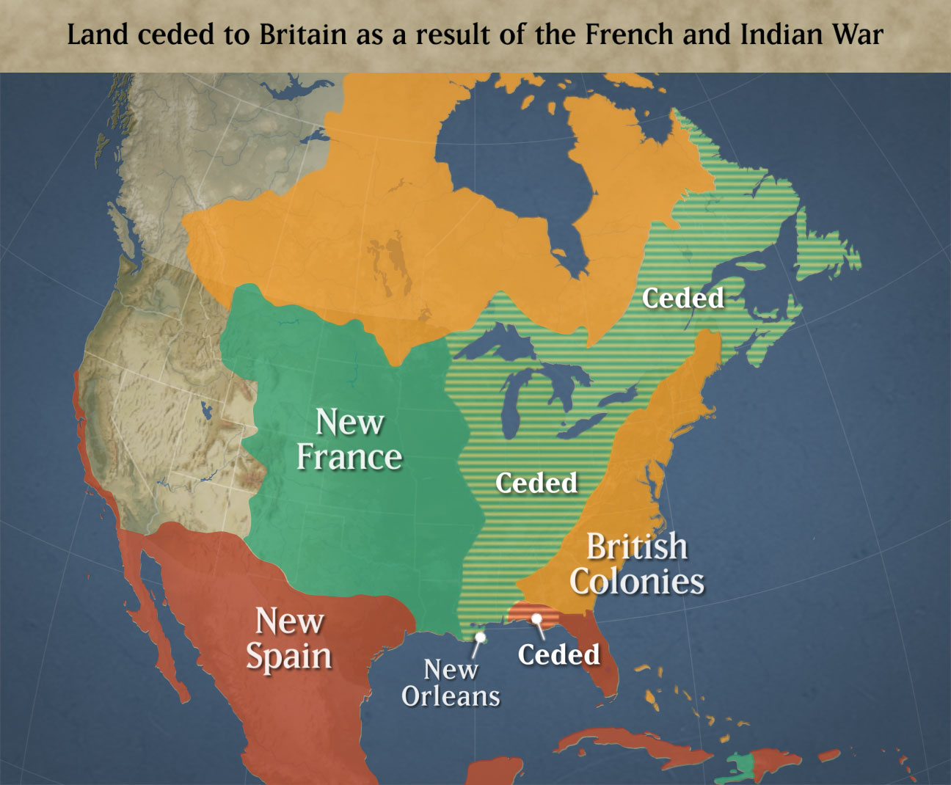
Effects of the French and Indian War 1754-1763
*After the war was over between Britain and France, Britain’s national debt was ____________
*There were also ___________ _______________ still in the colonies and Britain felt that the colonists should help pay for them.
*Britain planned on getting paid through ____________________ which angered the colonists.

Slide 12
Critical Thinking Question: Why do you think the colonists thought their own government could make decisions for the colony better than the King?
STAND AND TALK!

Slide 13
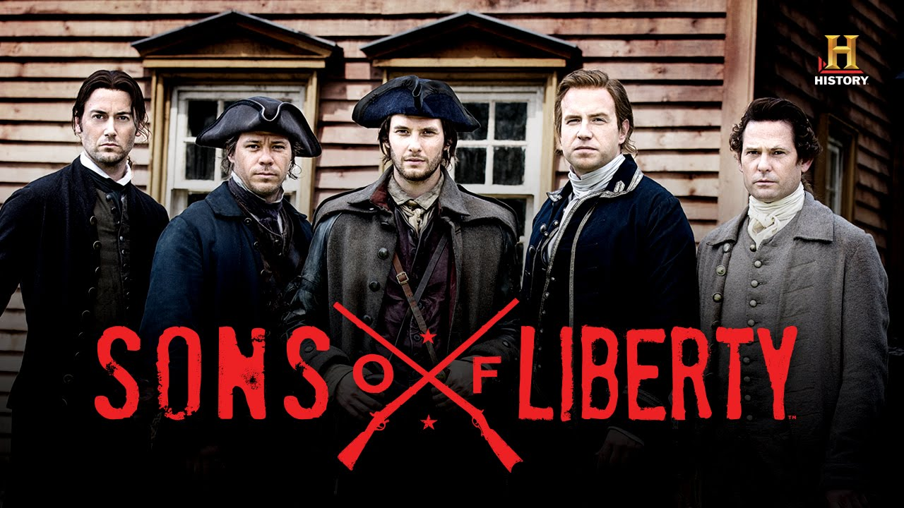
Sons of Liberty/Liberty Boys (1765)
*_______________ and ______________were the leaders of the secret group.
*The protests of the group often turned _________
*Britain sent ____________ to take care of the violence which angered the colonists more.
*Some colonists even had to _______________ soldiers in their own homes.
*The Sons of Liberty were responsible for the _____________

Slide 14
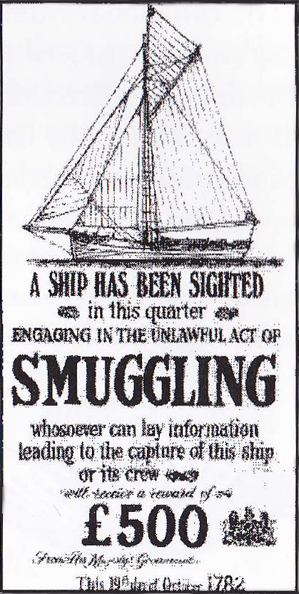
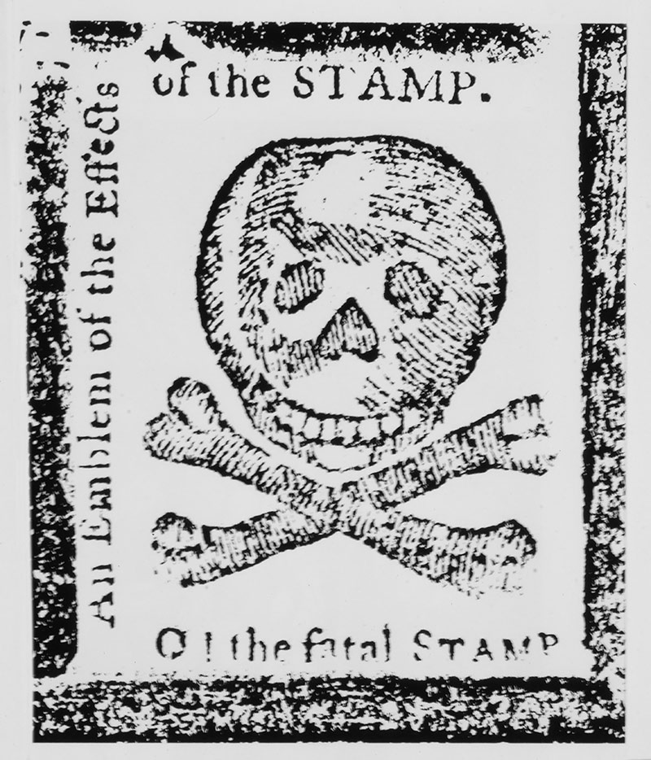
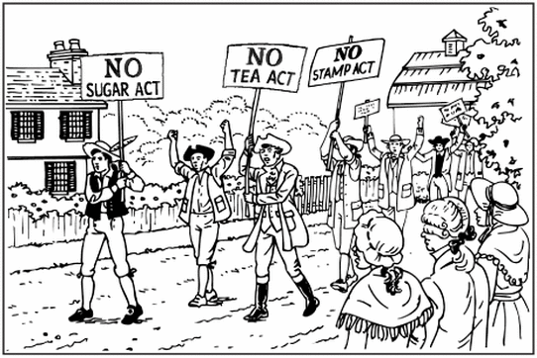
Taxation/Representation in Parliament 1765-1776
*The first tax imposed on the colonists was the _________ ________ (taxes of paper products).
*The colonists did not like being taxed without ____________________ (having a say).
*They feared that this small tax would lead to ___________ __________.
*Not paying taxes led to finding “ways around laws” such as ___________ and ___________.
*Colonists began to ____________ against Britain and the crown and form a national identity.

Slide 15
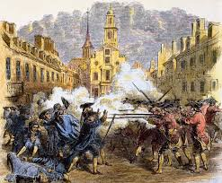
Boston Massacre 3.5.1770
*After taxes on basically almost everything, the colonists started _____________(not using/buying) British goods.
*Britain then sent MORE troops and the colonists started to incite __________ toward the soldiers
*_________ civilians were killed in the “massacre”
*__________ __________ volunteered to represent the soldiers in the trial even though he was a Patriot.
*The colonists view of the British soldiers changed after the trial seeing them as wanting to crush their ______________________.

Slide 16
Critical Thinking Question: Why do you think the colonists referred to this event as a massacre even though only 5 people died?
STAND AND TALK!

Slide 17
Boston Tea Party 12.16.1773
*The Tea Act put a tax on __________. Even though it was small the colonists still ___________ by ________________ in tea from other companies
*The King allowed the East India Tea Company (owned by Britain) to export tea to the colonies without paying _______________.
*This made their tea _____________ than the smuggled tea and therefore forcing the colonists to either pay the taxes on the cheaper tea or pay more for smuggled tea.
*Hearing that 3 chips full of tea were on their way, the __________ ____ ____________ disguised themselves as _____________, snuck onboard and _____________________________________ the tea.
*Britain angrily reacted with the ________________ Acts.

Slide 18
Critical Thinking Question: Why not just throw the crates into the Ocean?
STAND AND TALK!

Slide 19
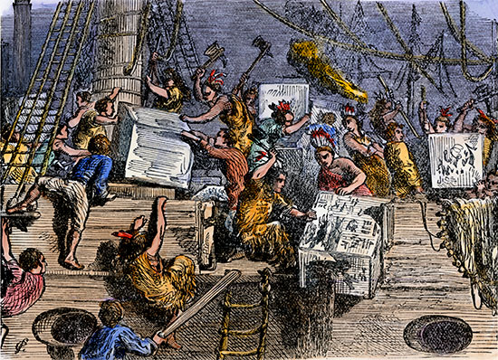
Boston Tea Party

Slide 20
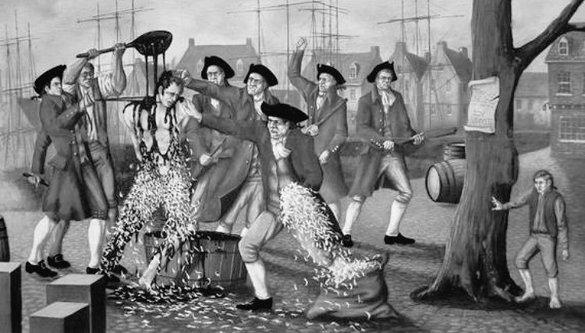
Intolerable Acts 1774
*The colonists saw these acts a ___________ _____________________ for the Boston Tea Party.
*The Acts actually made more colonists ___________________________________________.
*The angry colonists formed the first ___________________ ______________ and __________________ all British goods.
*When the war broke out ___________ of the colonies worked together to fight against Britain.

Slide 21
