Slide 1
Reminders
Keep everything organized in your binder. These will be checked.
5 OneSheets
4 background info sheets
Standards Journal Part 1
Once you enter my classroom doors, you are NOT allowed to leave.
Same rule since the beg of the year
You are taking advantage of my kindness with restroom breaks
Restrooms are 100% NOT allowed during seminar/lectures

Slide 2
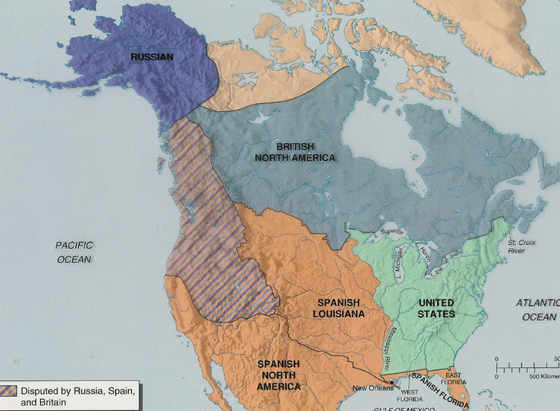
War is over, now what?
With the formal ratification of the Treaty of Paris 1783, the United States became not an idea or a statement, but a reality
This reality came with a set of challenges that the founding generation had to face
In this process the founders often differed on the philosophy and approach, but ultimately compromised on what would be best for a young, infant nation to survive in a very hostile world

Slide 3
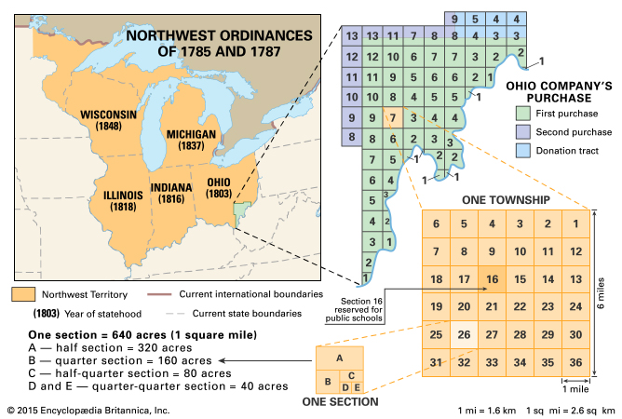
Major Challenges of Americans
Land and Westward expansion
Needed to be fair and orderly
Needed to formulate an Indian policy to prevent future conflicts
Needed to address continued British presence and Spanish sanctions

Slide 4
Major Challenges of Americans
2. Large war debt and how to pay it
Ask the states
Sell western land

Slide 5
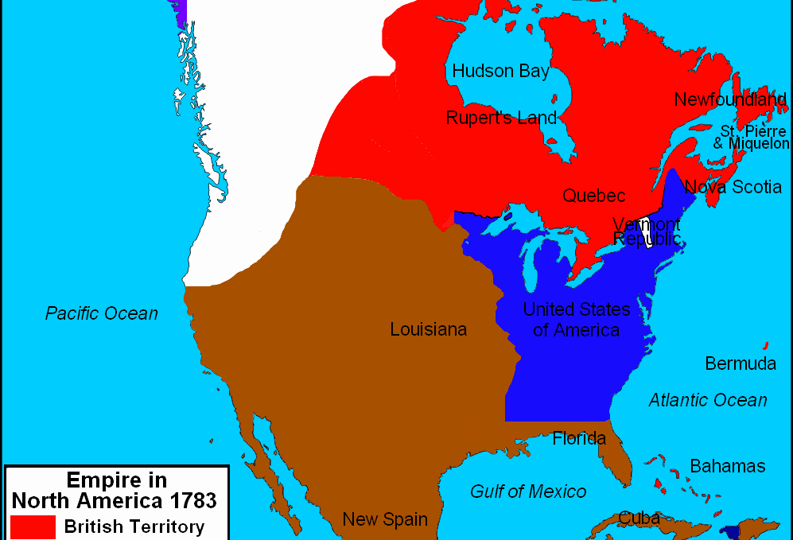
Major Challenges of Americans
3. Threats from Britain and Spain
Britain maintained an army and Forts in the Northwest
Britain imposed tariffs and blockades on American goods and shipping
Spain closed lower Mississippi and the port of New Orleans to American goods and shipping

Slide 6
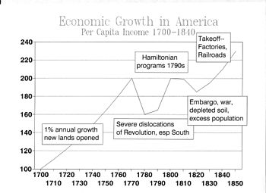
Major Challenges of Americans
4. Diminishing economy
The states made their own trade regulations
The states began printing their own money causing inflation
Inflation and unregulated economic activity cause an economic depression

Slide 7
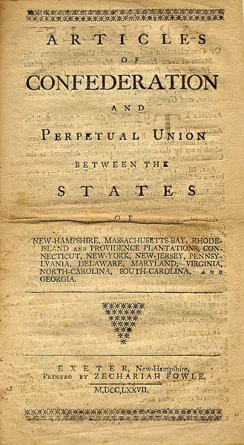
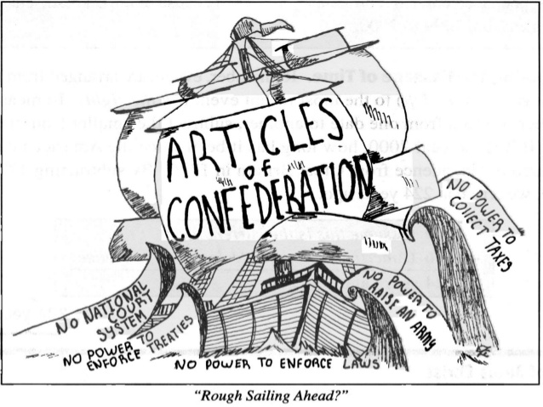
Articles of Confederation
Each state created it’s own government
Republic: people elect reps to govern on their behalf
1st document that created a central government in the newly independent states (1st written constitution)
Written by John Dickinson

Slide 8
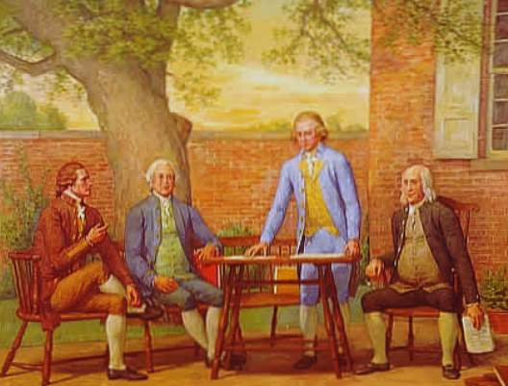
Articles of Confederation: strengths
The new national Confederation Congress had the power to
Wage war
declare peace
Coin money
conduct foreign affairs

Slide 9
WEAKNESSES
Cannot collect taxes or regulate trade
No judicial or executive branch
9 out of 13 states = change a law
All 13 had to agree to add a law
Only 1 vote per state
Cannot force states to use a single currency
Cannot draft an army

Slide 10
Central Gov’t
What is a “central government?”
Does the AOC create a strong or weak “central government?”
Why do you think the colonies created a WEAK central government?

Slide 11
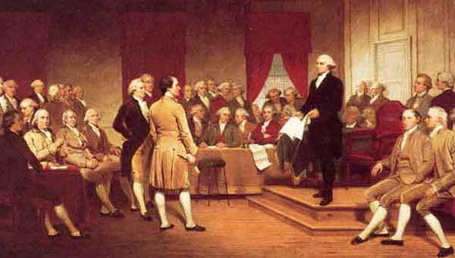
2nd Constitutional Convention
What was written during the 1st Constitutional Convention?
The 2nd Constitutional Convention was called due to the AOC being extremely weak and ineffective
1787 - Philadelphia
Only RI didn’t attend
55 Delegates attended

Slide 12
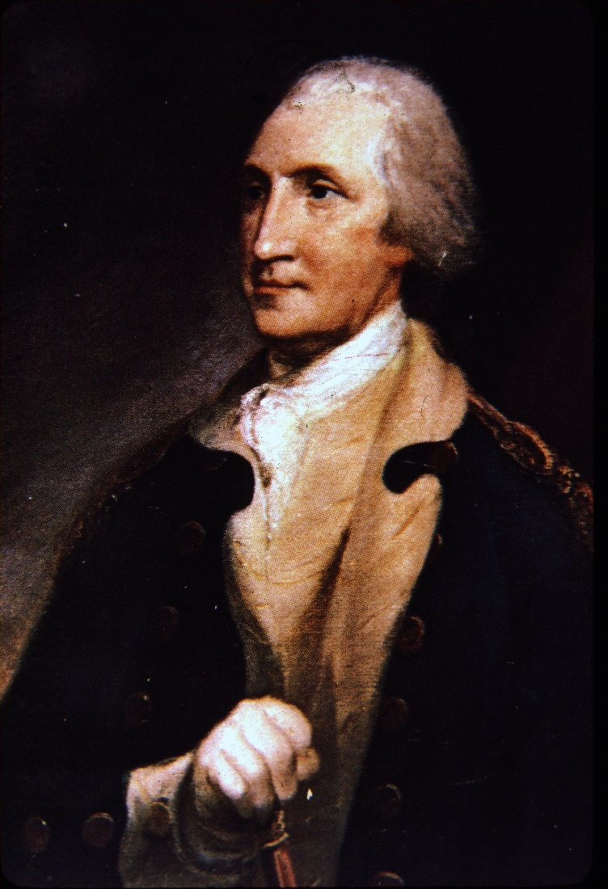
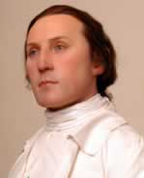
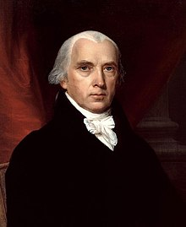
Leaders of the Convention
George Washington was asked to preside (lead) over the convention.
James Madison kept notes of the discussions and is often called “The Father of the Constitution.”
The men who wrote the Constitution are called the “Founding Fathers.”

