Slide 1
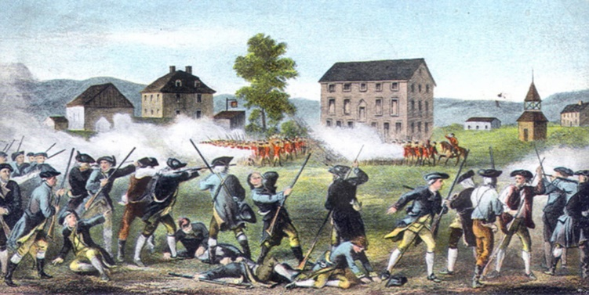
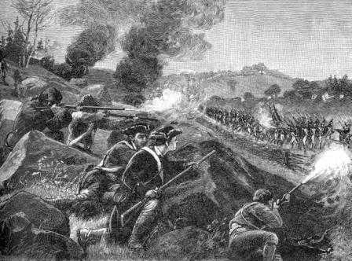
American Revolution
Battle of Lexington and Concord April 1775
“Shot heard around the world”
No one knows who fired it
Minutemen versus Redcoats
Guerilla Warfare
Hiding → surprise attacks
British considered this unfair and cowardly
Who won is not important…the British now saw the colonists as a force to be reckoned with. The colonists were stronger than the British thought.

Slide 2
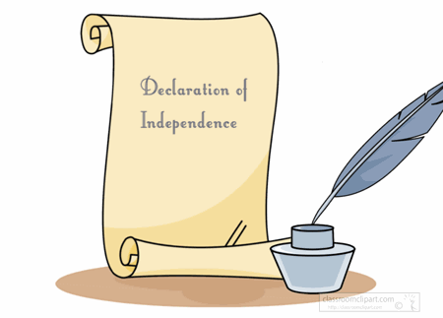
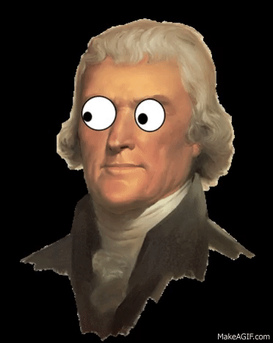
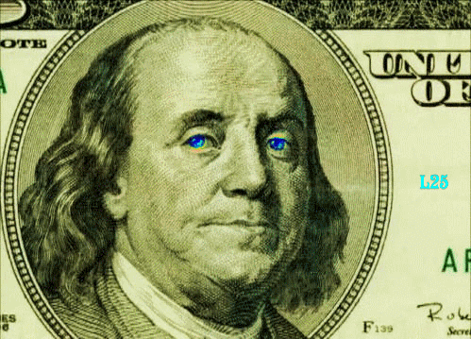
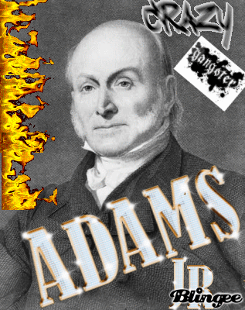
The Declaration of Independence
Preamble
Why are the colonists writing this letter?
Natural Rights
What all humans should have
Grievances
List of complaints about the King of England
Declaration
Announces independence

Slide 3
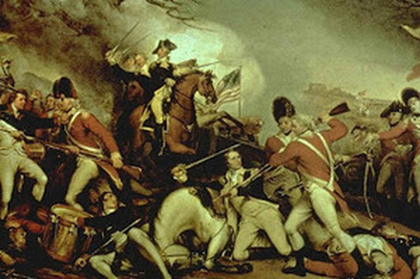
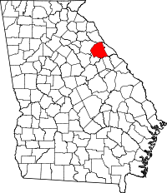
Kettle Creek GA 1779
The Georgia militia, defeated 800 British troops (Loyalists) near Washington, Georgia
Great victory for morale (confidence) of the militia and Georgians seeking independence (Patriots)
Won badly-needed weapons and horses from the British

Slide 4
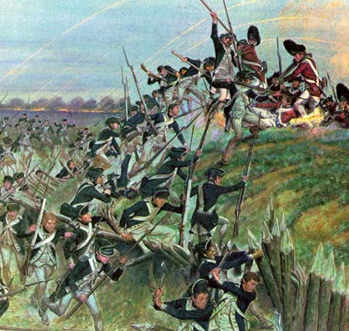
Siege of Savannah 1779
With new confidence from Kettle Creek, 15000 Americans and 4,000 French attacked British-held Savannah
Attack on October 9 resulted in 1,000 American, Polish, and French deaths in less than an hour; only 40 British troops died
Savannah remained under British control
Guerrilla warfare (small scale fighting; sneak attacks) continued in the Georgia backcountry

Slide 5
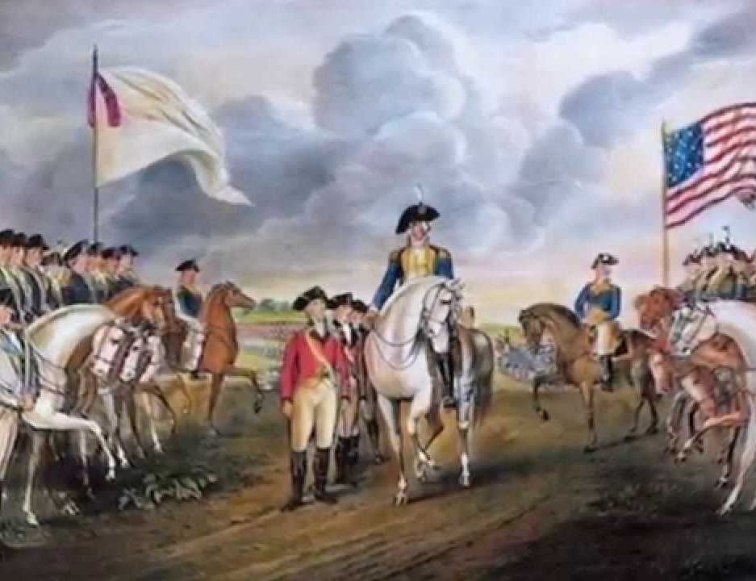
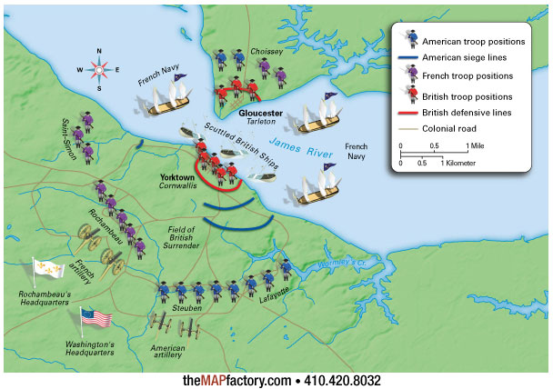
The finale 1781
Battle of Yorktown
Britain started to retreat
They backed themselves into a corner on a peninsula in Yorktown, VA
The Continental Army and French cornered them until they waved the white flag.
Cornwallis surrendered
Sep 1783 Treaty of Paris signed
Colonies are officially free
AMERICA!

Slide 7
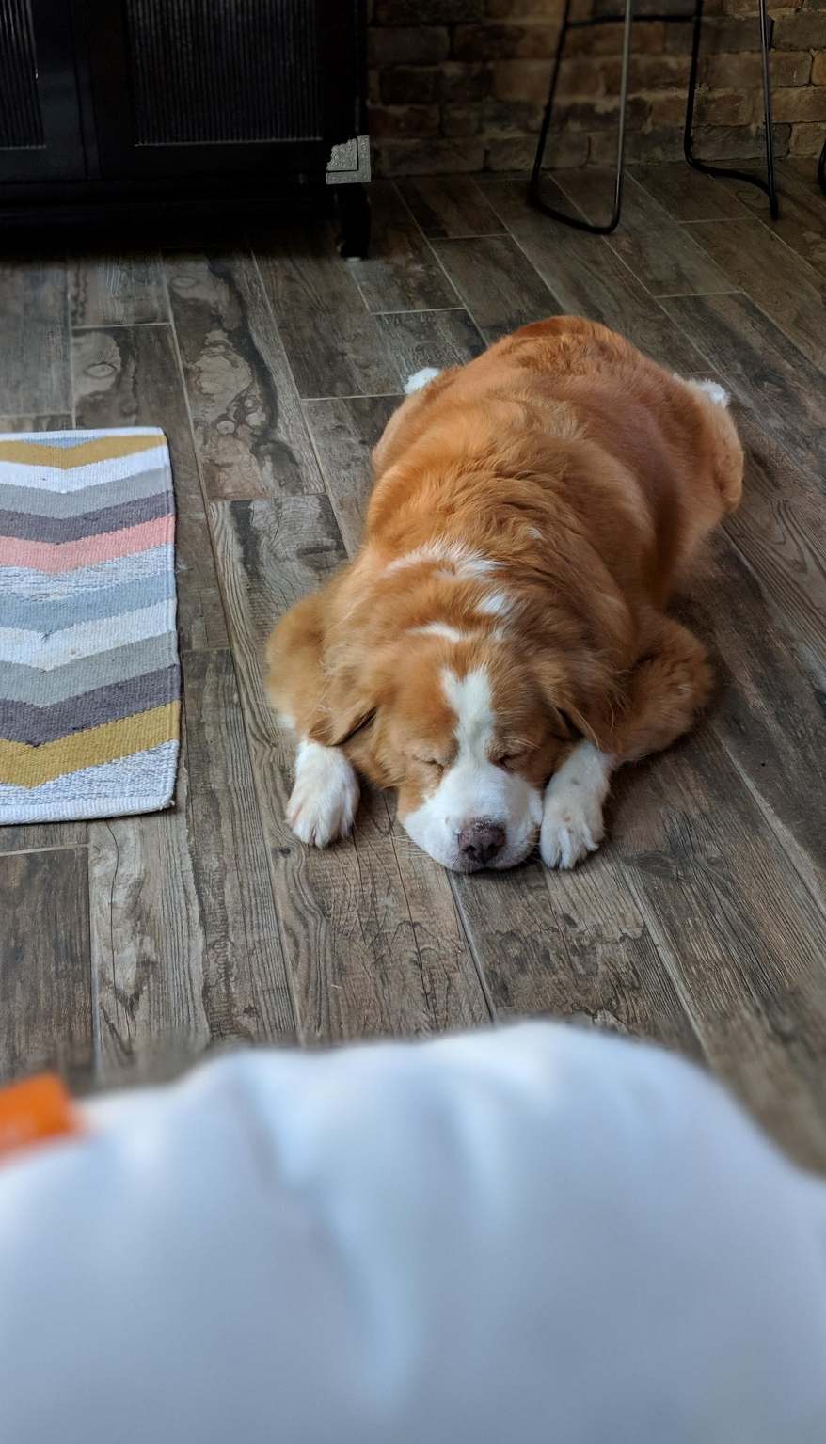
SS8H3 Timeline Activity
You will work as a TEAM
Everyone will participate
10 Events
Each needs a picture/symbol that represents it (not just something that’s cute)
Each needs a detailed description (that is NOT 1 sentence)
Each needs to be legible
NO PENCIL!!!! (pet peeve)

