Slide 1
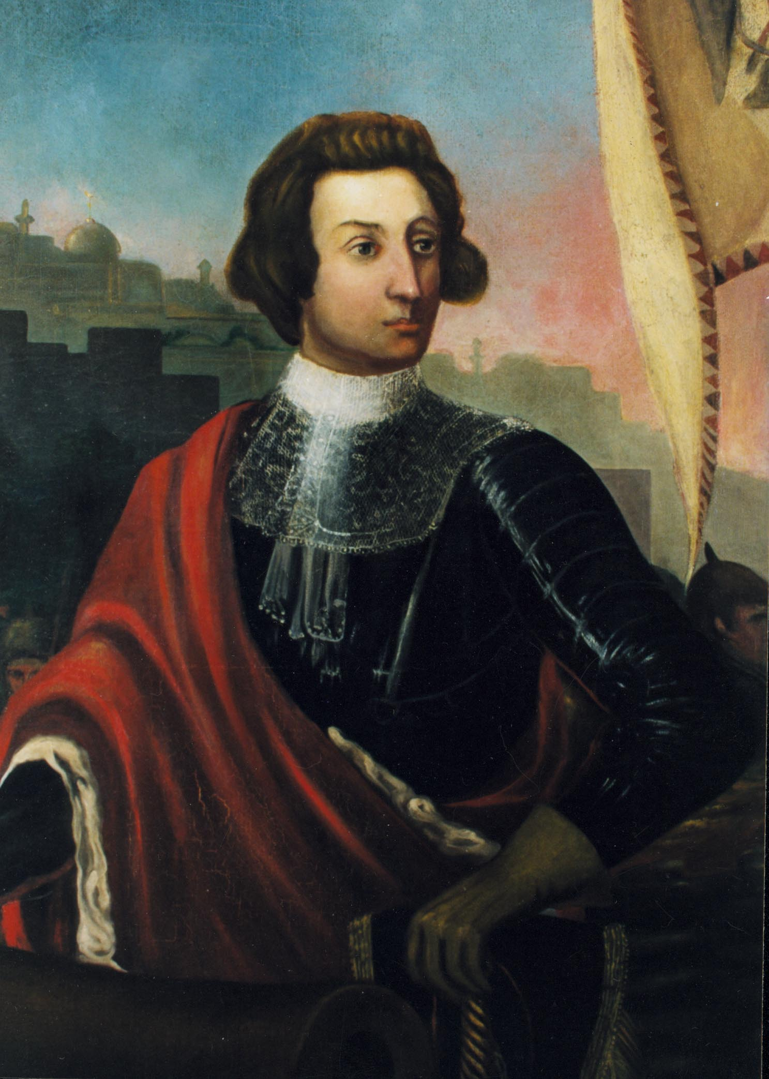
James Oglethorpe
This is my good side…
Credited as the founder and first governor of Georgia
1722: elected to British Parliament
Was instrumental in an effort for British prison reform
Had a friend in prison for his inability to pay his debts, died in terrible conditions
Oglethorpe wanted to establish a colony for those in debtor’s prison and the worthy poor.

Slide 2
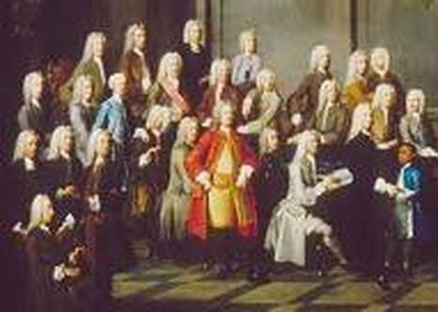
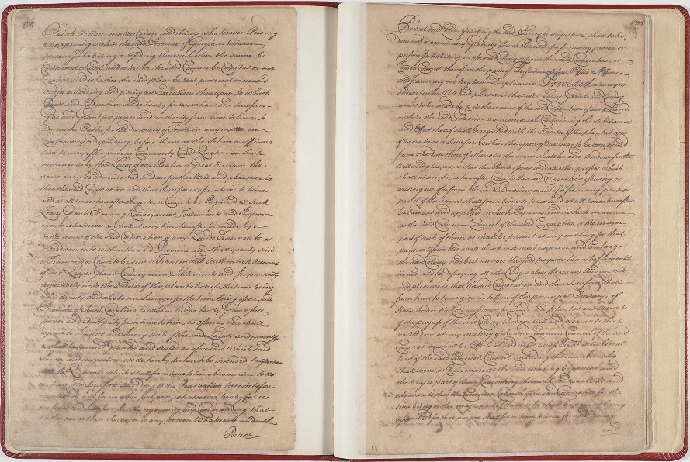
Reasons for founding Georgia
Oglethorpe asked King George II to award a charter that would allow a colony to be established south of the Carolinas.
*Charter: a written document signed by the king that granted certain rights
*Charter of 1732: outlined in detail the reasons for Georgia’s settlement and rules for the colonists.
-Example: religious freedom, except Catholics and Jews

Slide 3
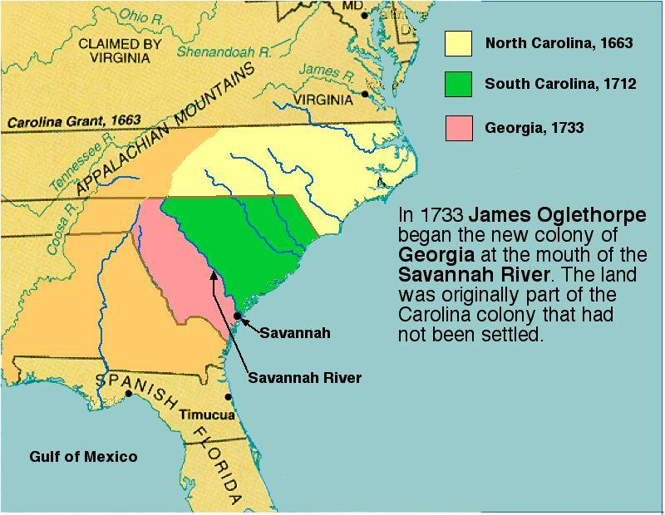
Reasons for founding Georgia
Defense: The most important reason for founding Georgia
*South Carolina was constantly threatened by Spain in Florida.
*Georgia’s primary role was to serve as a military buffer between the two.

Slide 4
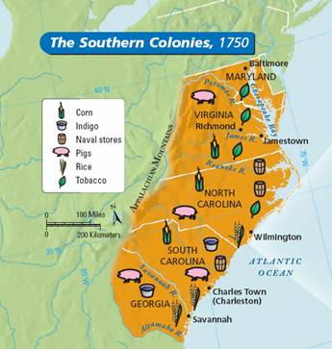
Reasons for founding Georgia
Economics: Britain’s economic policy of mercantilism
- Mercantilism: to build economic strength, a nation must export more than it imports.
- Britain used the raw goods (natural resources) to produce manufactured goods that were sold in European markets and back to the colonies.
- The natural resources Georgia was responsible for:
W - wine
R – rice
I - indigo
S - silk
T - tobacco

Slide 5
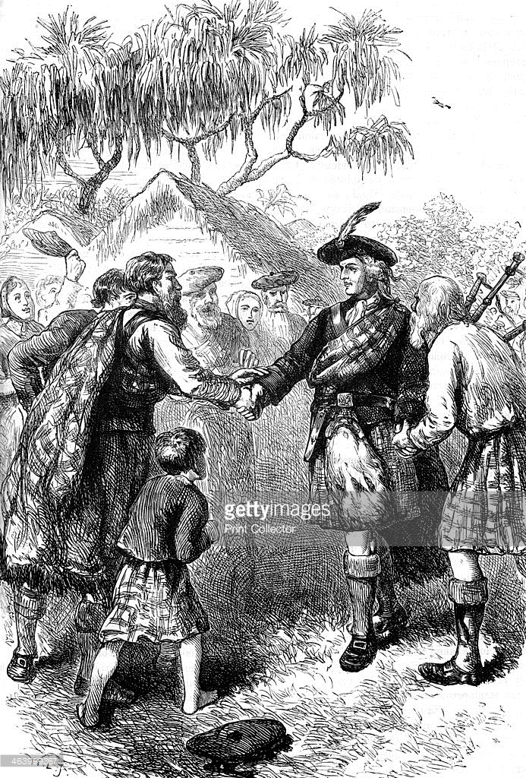
Reasons for founding Georgia
Charity: poor and unemployed could apply to travel to the new colony
Oglethorpe originally wanted debtors to be released from prison
They could pay back debts through working hard for the King
No one was ever released from prison to settle in the New World.
What vocab word is a synonym for Charity?
Philanthropy!!!!!!!!!

Slide 6
Charter of 1732
Bring me all of the fancy things.
Officially established Georgia named in honor of King George II.
Georgia would be ruled by a group of 21 Trustees for 21 years.
After 21 years, rule would revert to the king.

Slide 7
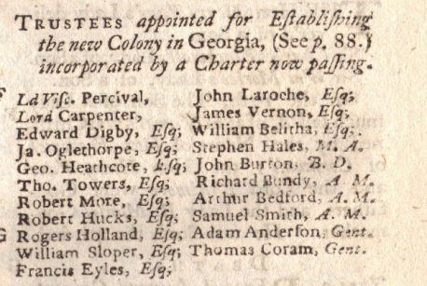
Rules of the Charter of 1732
No alcohol or slaves for fear that the colonists would get lazy
No liquor dealers, lawyers, or Catholics
Required to defend the colony
Grow mulberry trees to produce silk
Not sell the land

Slide 8
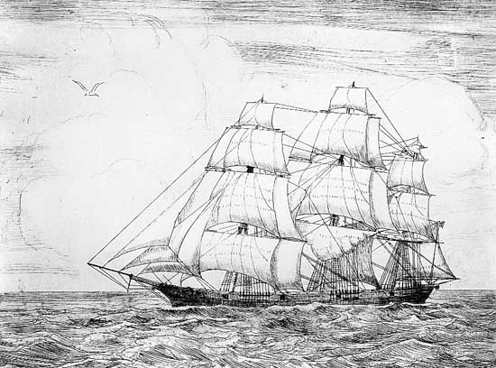
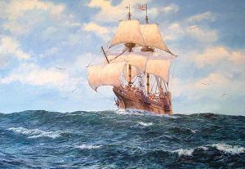
Arriving in Georgia
Chosen colonists, mostly tradesmen, left England (35 families, 114 people) aboard the ship Anne on November 17, 1732.
They arrived in South Carolina on January 13, 1733.
Oglethorpe searched for a place to settle.

Slide 9
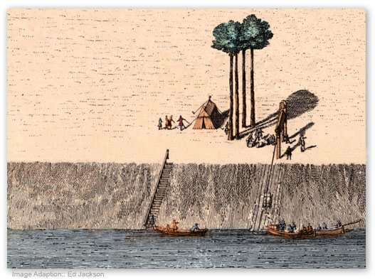
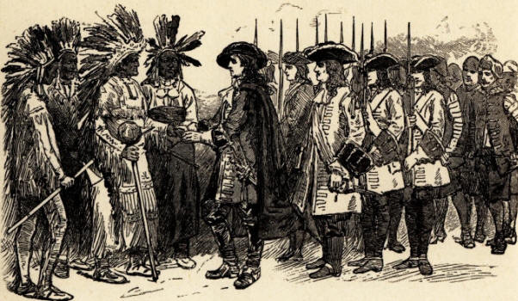
The land Oglethorpe chose
He selected a high bluff overlooking the Savannah River. (It was known as Yamacraw Bluff.)
The cliff served as protection on one side
They also needed water access for trade and arrival of supplies and future families.

Slide 10
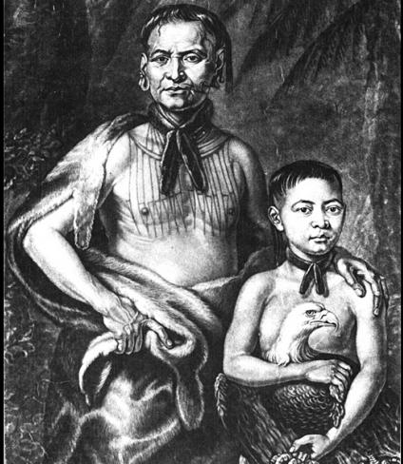
The land Oglethorpe chose
He met the Yamacraw Indians and their chief Tomochichi.
Mary Musgrove acted as an interpreter between Oglethorpe and Tomochichi.
Her contributions were critical to the founding of Savannah and Georgia.
Tomochichi and Oglethorpe became friends and established peaceful relationships with the Creeks and other tribes.
In February 1733, Oglethorpe and the colonists cleared land and founded the new city of Savannah.

Slide 11
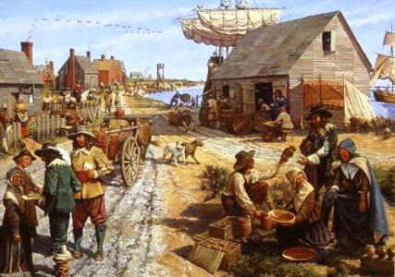
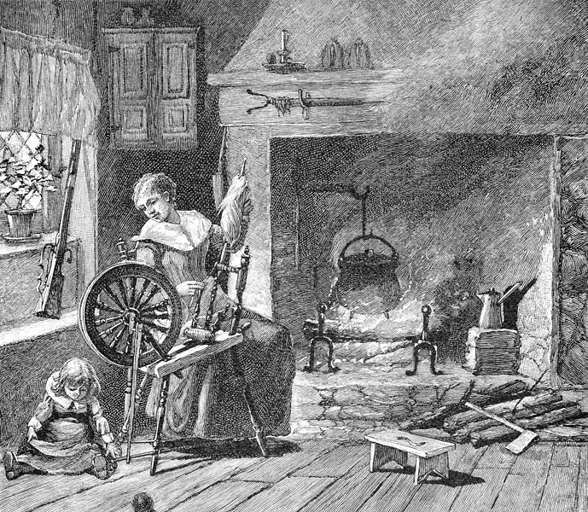
Trustee Period
Trustee Period Trustees governed Georgia from 1733 to 1752.
Several ethnic groups wanted to settle in Georgia.
Remember: Catholics and Jews were not allowed in the colony per the Charter of 1732
Jews, Protestants, Scotish
Others were slowly turning against the Trustees and the colony.

Slide 12
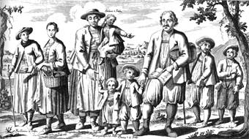
Jews in GA
In July 1733, a group of Jewish immigrants arrived.
Dr. Sam Nunes arrived on a boat
Colonists (including their only doctor) were dying of Yellow Fever
Oglethorpe welcomed them with open arms even though it was against the King’s orders.

Slide 13
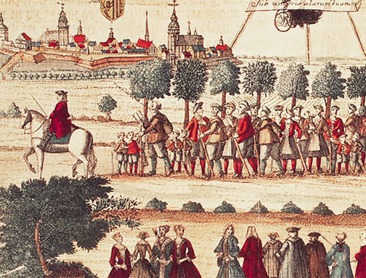
Salzburgers in GA
In 1734, a group known as Salzburgers arrived in search of religious freedom and a hope to begin a silk industry.
They were Austrian Lutherans. They founded a settlement Ebenezer.
Ebenezer's lumber became a valuable commodity.
Widows and orphans operated the first silk production in Georgia.
They were extremely hard workers and Oglethorpe liked them.

Slide 14
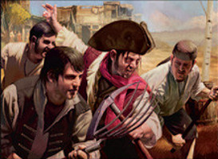
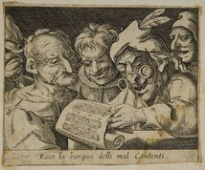
Don’t be a Malcontents!
They thought the rules kept the colony from being prosperous.
The dissenters became known as malcontents.
They complained about:
the limits placed on buying and selling land
the right to buy alcohol
the ban on slavery
Economics won out!
By 1750, slavery was legal, land could be bought and sold, and liquor could be produced and sold.

Slide 15
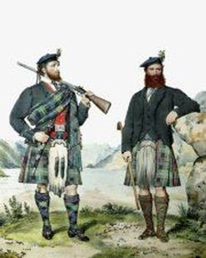
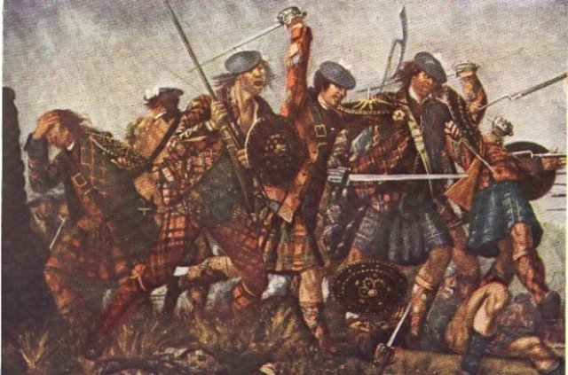
Scotish in GA
Oglethorpe brought over the Highland Scots
Known for being some of the best soldiers in the world
Oglethorpe wanted protection from the Spanish in Florida
They fought bravely in the Battle at Bloody Marsh.

Slide 16
Change in Government
Georgia became a Royal Colony when the Trustee Period ended in 1752.
Definition: Royal Colony – Colony overseen by the crown of England.

Slide 17
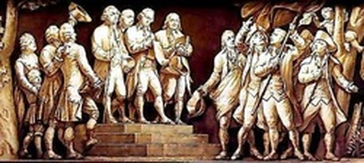
Change in Government
The British Parliament had to pass a charter in order for Georgia to become an official Royal Colony. This process took two years. Georgia would not get its first official royal governor until 1754.
The government of Georgia would change drastically as the people, under the leadership of the Royal Governors, would have to learn to govern themselves.

Slide 18
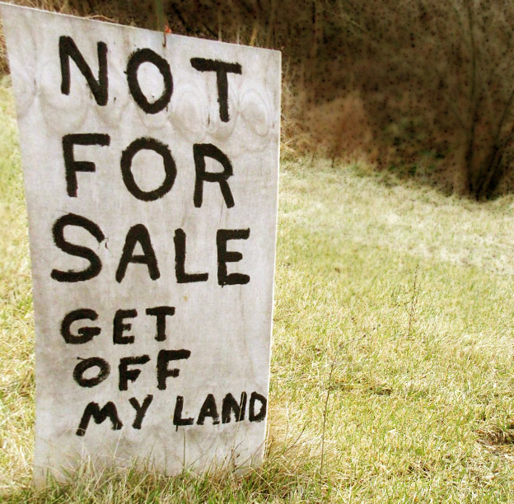
Land Ownership…
Trustee Land Ownership:
Through “charity” 50 acres of land max
Colonists purchase 500 acres max
Men only
Royal Land Ownership:
Anyone could purchase more land, no max
Permission to use slaves
Women could inherit land

Slide 19
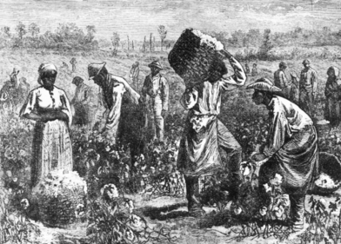
Slavery
Slavery was not allowed by Oglethorpe and the Trustees
Royal Colony:
Wealthy colonists who could afford to buy enslaved people demanded to be allowed to bring them to Georgia. Many farmers believed that in order to compete with neighboring states (like South Carolina) they had to be allowed to own slaves.
Between 1750 and 1775, the number of Africans living in slavery increased from 500 to 18,000. These slaves had no rights, were not allowed to marry, were not allowed to live where they wanted, and were not allowed to learn to read or write. Slaves who broke these rules were punished, including beatings, whippings, separation from friends and family, and even death.

Slide 20
