Slide 1
How long can you survive…
Without water?
3-4 days
Without food?
3 weeks
Without sleep?
11 days
In 0 degree water?
15-45 minutes

Slide 2
First humans in the Americas
What would be some challenges they would face?
What do you think they had with them?
Would you be able to survive in a new undiscovered planet on your own?

Slide 4
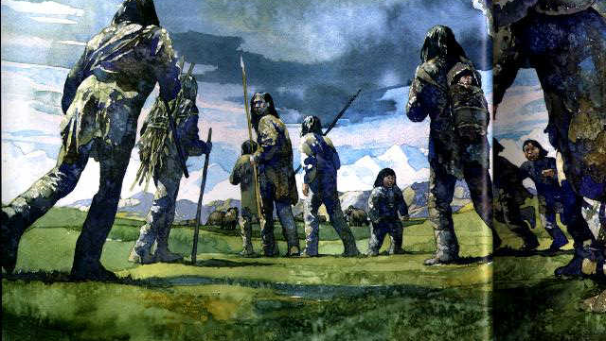
Migration/Movement
What does migration mean?
Where did the first Native Americans come from?
When did the first human beings arrive in America?

Slide 5
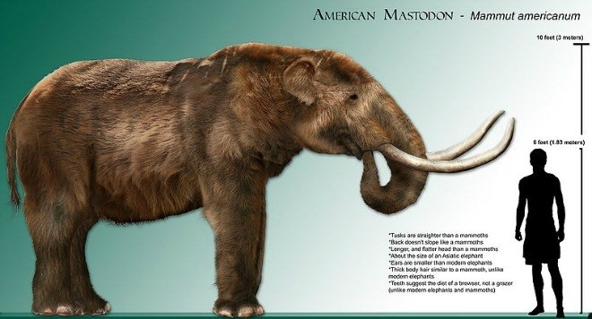
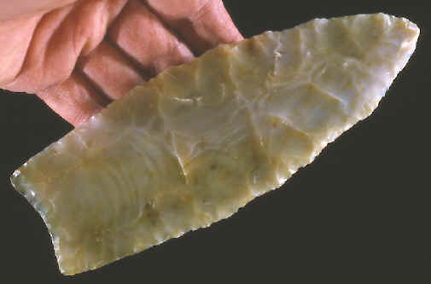
Earliest People
In search of food.
They followed big game animals. (woolly mammoths, mastodons, caribou, and moose).
Used Clovis points to hunt
Very Nomadic

Slide 6
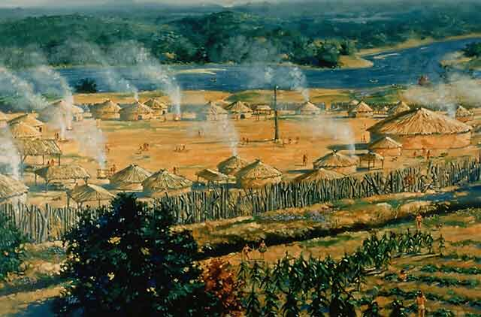
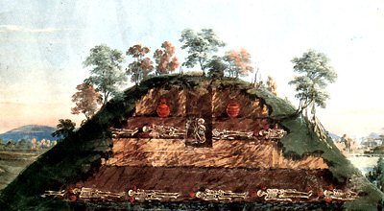
Mississippian American Indians
How were they organized?
chiefdom- hierarchical society of “elites” (power holders) and “commoners” (work force)
Where did they live?
large towns near rivers that featured a central plaza, residential zones and defense structures (palisades, guard towers, and moats).
Describe Earthen Mounds…
The focus of the plaza was the earthen mounds dedicated to religious and social activity. Some served as cemeteries.

Slide 7
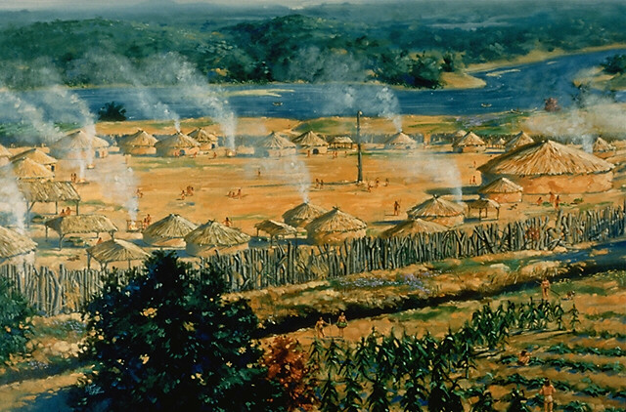
Mississippian Towns
Describe their houses…
Thousands of families lived in the towns.
One-room wattle and daub shelters (walls built of a network of interwoven sticks and covered with mud or clay) served as sleeping facilities as they usually spent their days in the open.

Slide 8
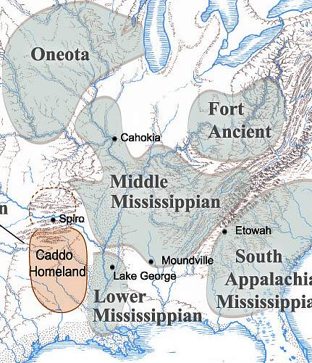
Mississippian Society and Culture
What is their economy based on?
A widespread trade network connected Mississippian towns.
What did they trade?
raw materials as well as finished goods, including shell beads, pottery with abstract images, and stone tools.

Slide 9
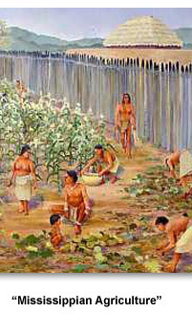
Agriculture and Hunting
What activity did they practice?
horticulture (garden cultivation)
eventually moved into large scale agriculture as their population swelled.
What was their number one crop?
maize (corn)
eventually added squash, sunflowers, pumpkins, and beans.
What was different about their farming from today’s farmers?
did not plant fields of individual crops. Instead, the fields were intermixed with a variety of plants.

Slide 10
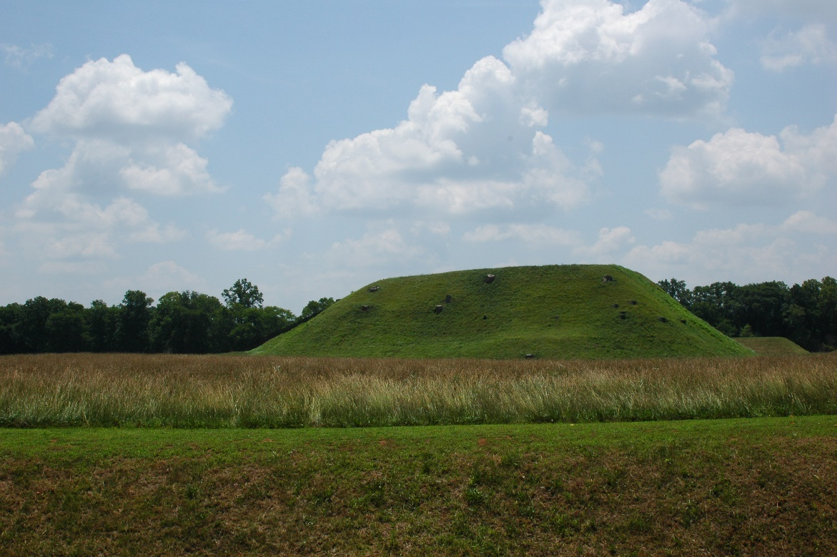
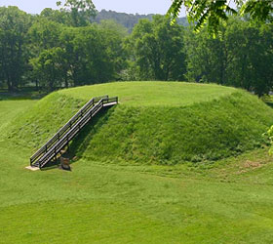
ETOWAH INDIAN MOUNDS
Cartersville, GA
Home to several thousand Native Americans between 1000 CE to 1550 CE
54-acre site
contains six earthen mounds, a plaza, village area, borrow pits and defensive ditch.
The most intact Mississippian Culture site in the Southeastern United States.
only 9 percent of this site has been excavated
Notes:
10

Slide 11
What are the 3 G’s?
God
Gold
Glory

Slide 12
What was the main reason European’s started to explore the “New World?”
To “get rich”→ Economic dominance

Slide 13
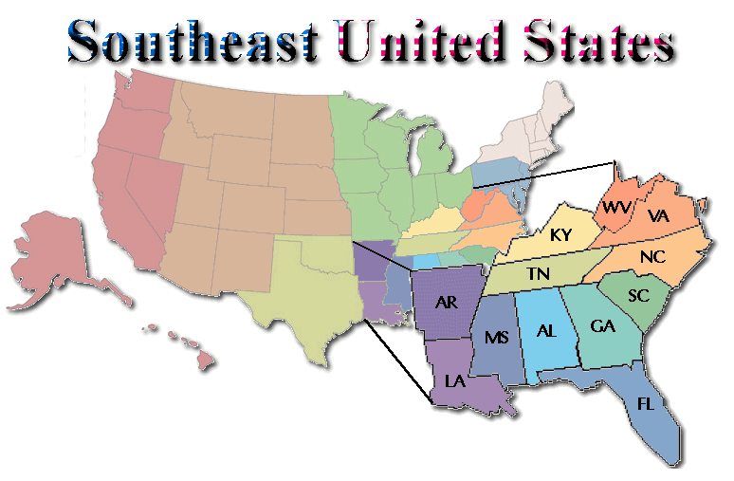
What did Spain really want?
North America (Southeast)

Slide 14
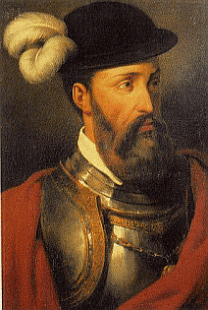
Spanish goals of exploration:
What was Spain’s goal relating to “God”?
Convert all Indians to Christianity
What was Spain’s goal relating to “Gold”?
Fill the King’s treasury with gold they discovered in America
What was Spain’s goal relating to “Glory”?
Gaining fortune and fame

Slide 15
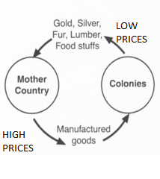
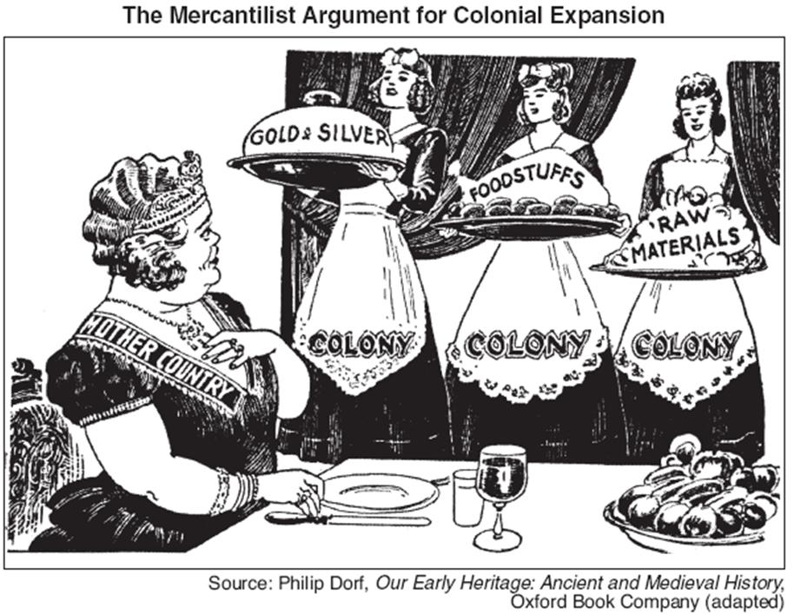
England supported what system of economy?
Mercantilism

Slide 16
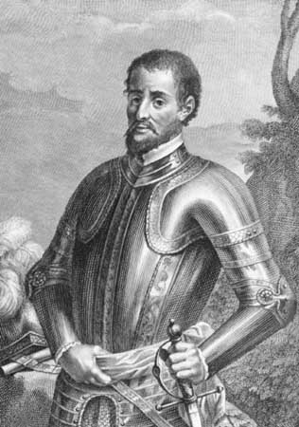
Hernando De Soto
Hola
In 1540, a Spanish conquistador (Explore and Conquer) named Hernando De Soto led 600 soldiers across Georgia.
1st explorer to adventure through Georgia
De Soto was searching for “cities of gold”.
De Soto’s men tortured and enslaved the natives in order to gain information about gold and silver locations.
He never found the gold, but he did leave a lasting impact on the Native Americans in Georgia.

Slide 17
Plagiarism
the practice of taking someone else's work or ideas and passing them off as one's own.

Slide 18
Plagiarism
PLAGIARISM!

Slide 19
Plagiarism
Not PLAGIARISM!

Slide 20
Plagiarism
Not PLAGIARISM!

Slide 21
Plagiarism
PLAGIARISM!

Slide 22
Plagiarism
PLAGIARISM!

