Slide 1
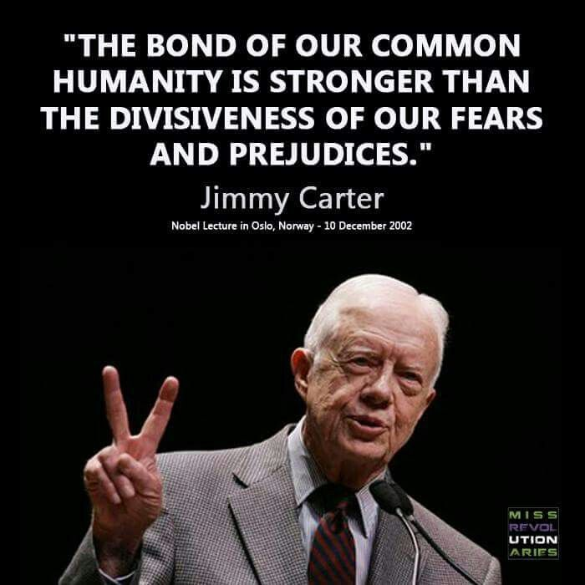
Jimmy Carter
1924-present (Plains, GA on a peanut farm)
1962 GA senate, focused on education
1970 GA Governor
People earned jobs based on merit
No more “good ole boys”
More women and Africa-Americans
Focused on GAs education, justice, mental health institutions
1976 POTUS
Americans upset about poor economy
Wanted someone Democratic to fix it

Slide 2
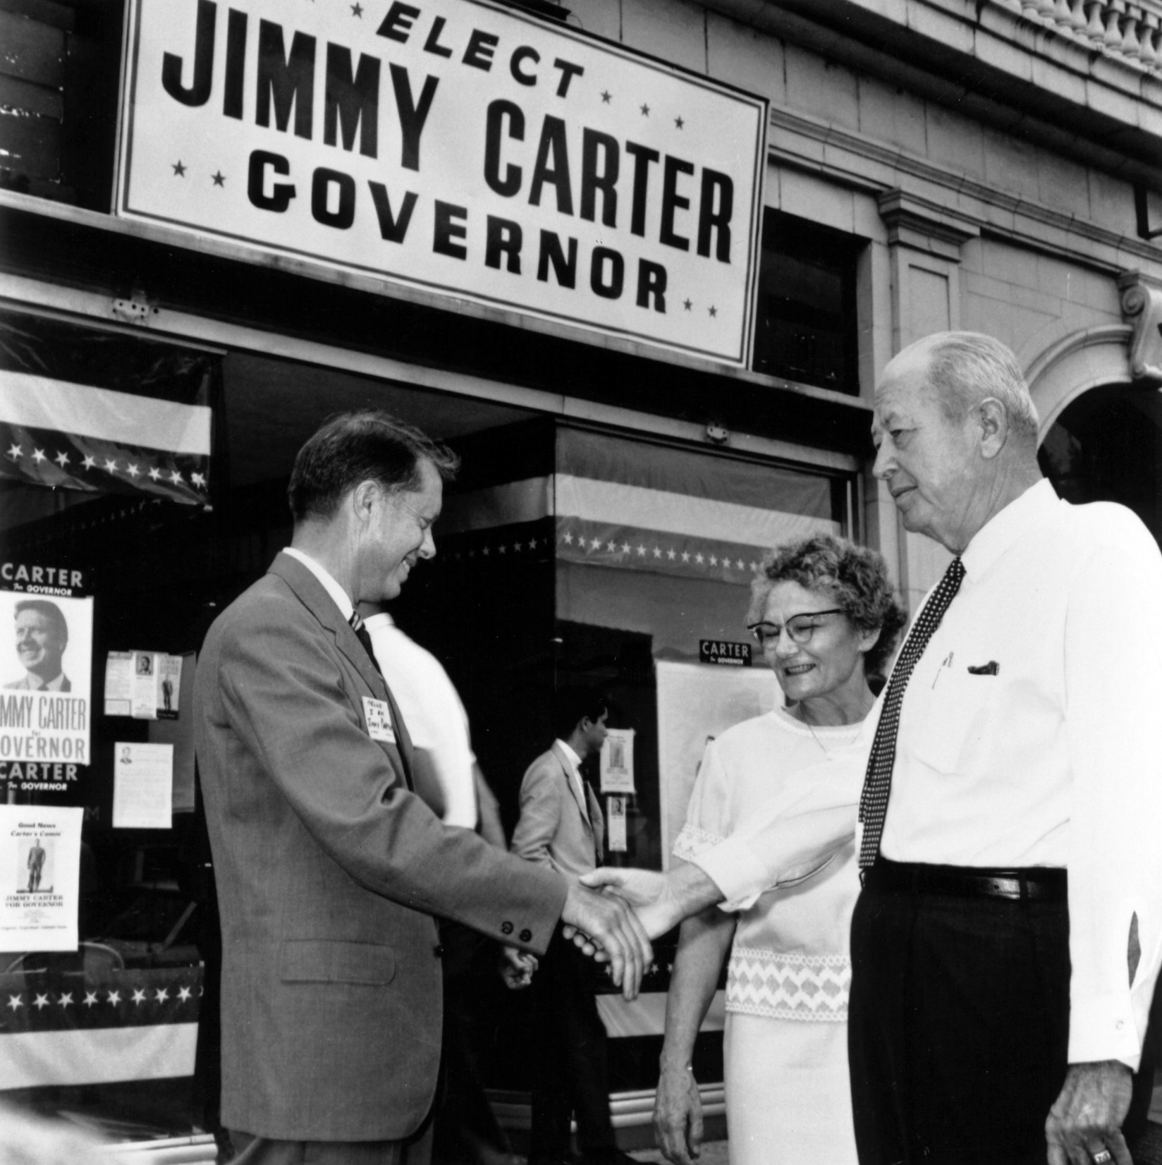
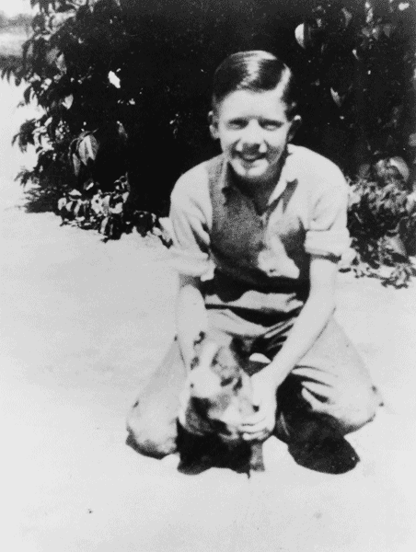
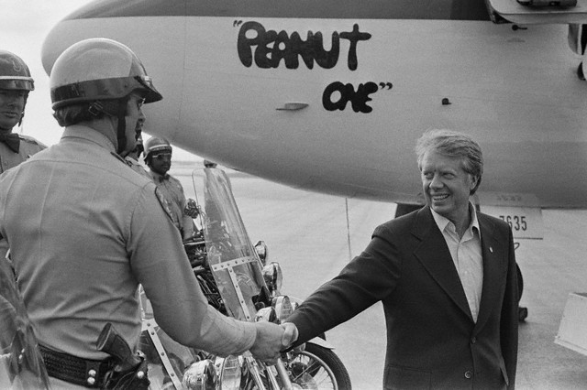
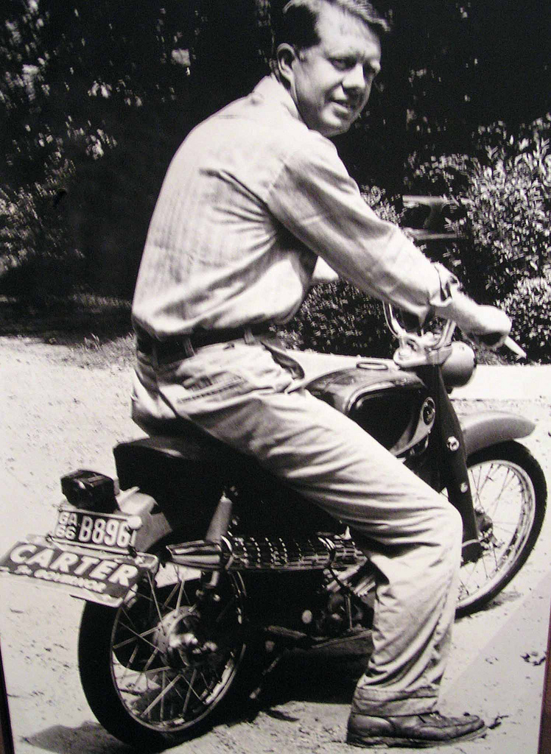
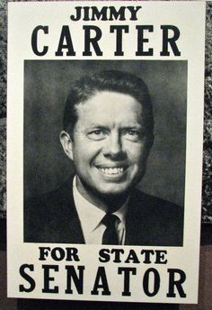

Slide 3
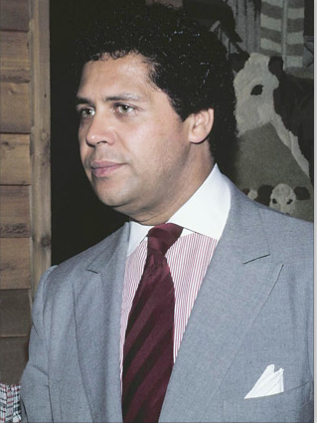
Maynard Jackson
1938-2003
1st African American mayor of a southern town
Atlanta Georgia
Was only 35 years old
Served 3 terms as mayor
Expanded the airport
Brought more contract jobs to African-American owned businesses
He hired more African American police
Ran for senate but died that year
Helped get 1996 Olympics in atlanta

Slide 4
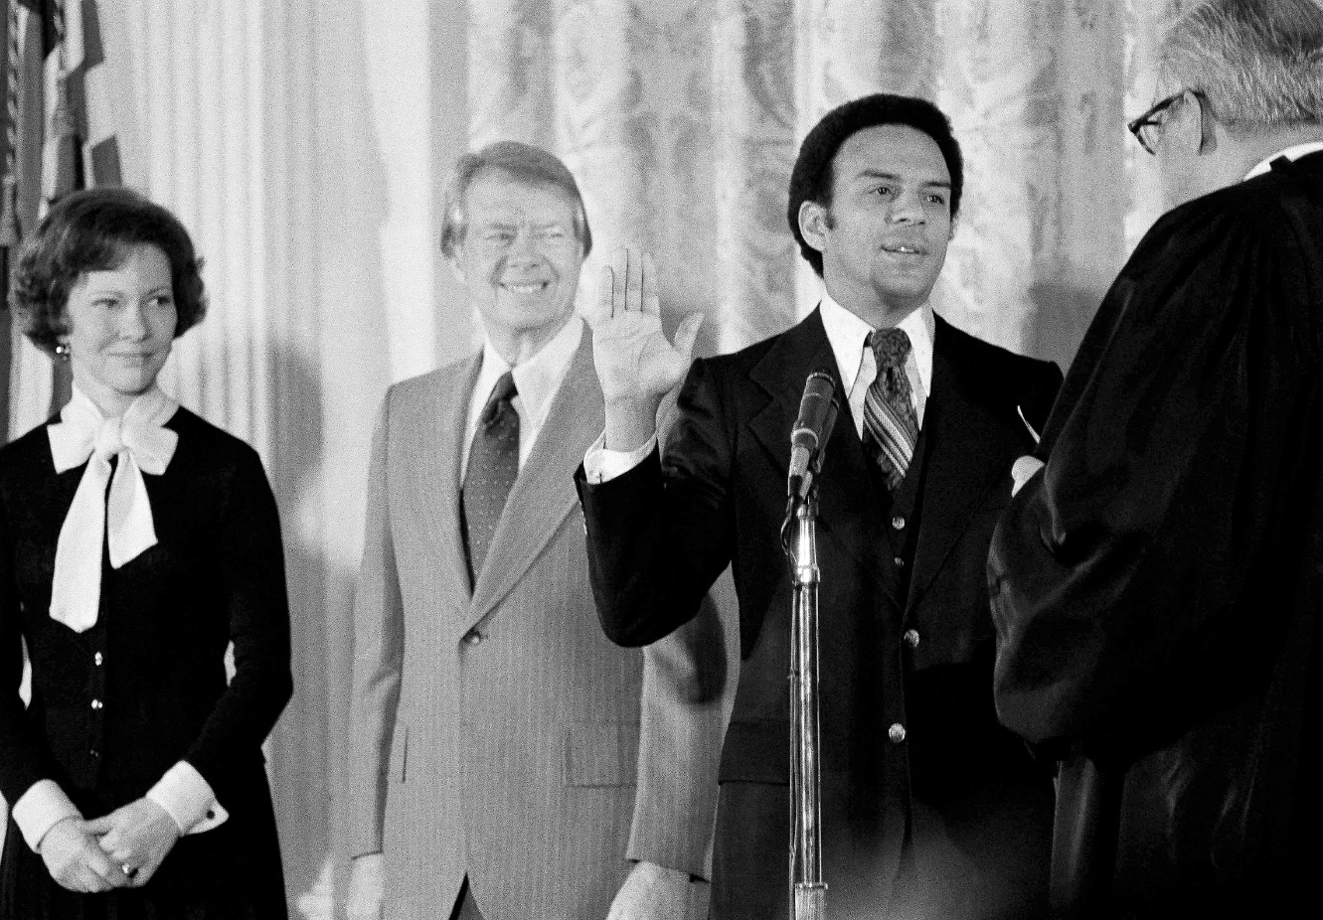
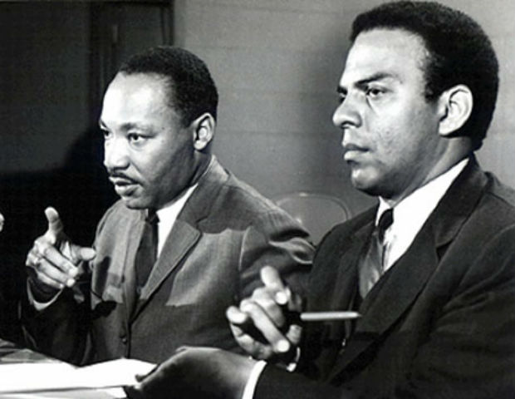
Andrew Young
1932-present
Active in civil rights mvmt
Voter’s registration drives
1961 joined SCLC
Besties with mlk jr
1972 elected first black congressman since reconstruction
1977 president jimmy carter appointed him ambassador to the united nations
1981 mayor of atlanta
Credited with getting 1996 Olympics to be hosted in atl

Slide 5
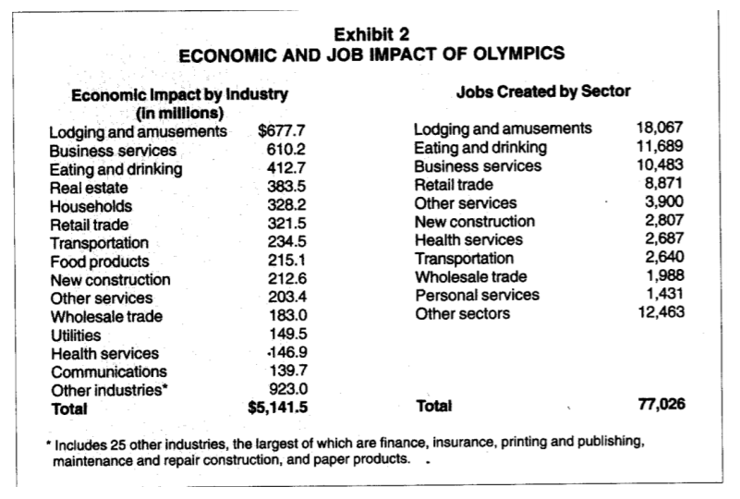

Slide 6
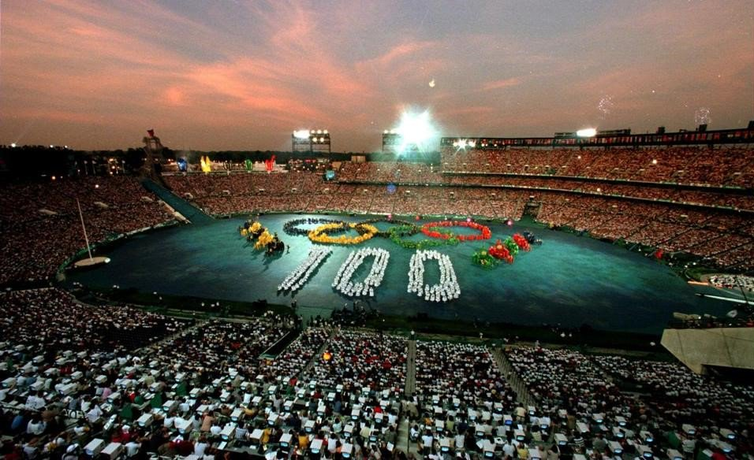
1996 Olympics Atlanta GA
Over 1 billion in construction
$5 BILLION economic impact
6 years of prep
Over 2 million visitors
Where did the money come from?
Public money
Corporate sponsorships
Ticket sales
Private investments
Hotels
Restaurants chains

Slide 7
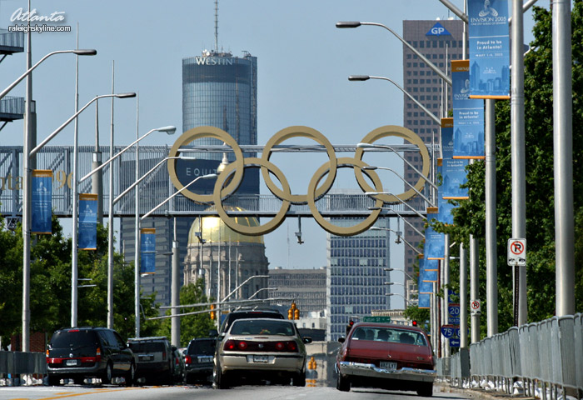
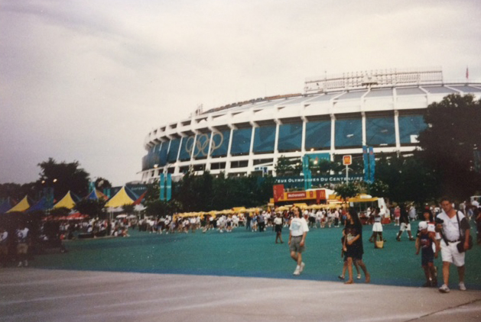
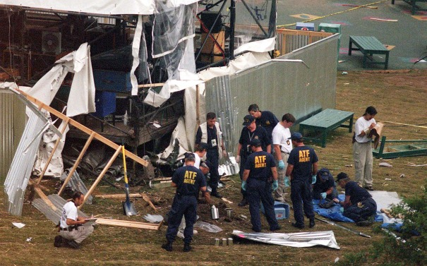
1996 Olympics Atlanta GA
Negatives:
People gathered to watch concerts in the newly designed parks
Pipe bomb went off and killed 2 people
Street vendors leased out sidewalk space
Harassment of people watching the games and walking through the streets
Short term impact
People left and so did the money
Traffic increased
More people, more cars

Slide 8
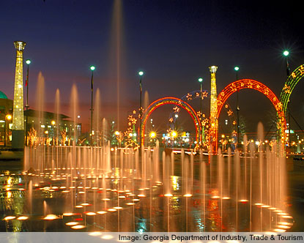
1996 Olympics Atlanta GA
https://www.olympic.org/atlanta-1996
Why Atlanta?
Southern hospitality
Birthplace of MLK JR
Center of the Civil Rights Mvmt
Long Lasting Impact?
Population increased (round the clock foot traffic)
Pedestrian friendly signs and crosswalks and sidewalks
Atlanta gained global attention

