Slide 1
SS8H10 Evaluate key post-World War II developments in Georgia.
Explain how technology transformed agriculture and created a population shift within the state.
Explain how the development of Atlanta under mayors William B. Hartsfield and Ivan Allen, Jr. impacted the state.
Describe the relationship between the end of the white primary and the 1946 governor’s race.

Slide 2
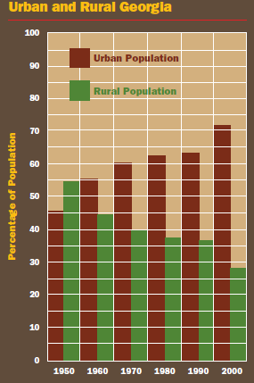
Explain how technology transformed agriculture and created a population shift within the state.

Slide 3
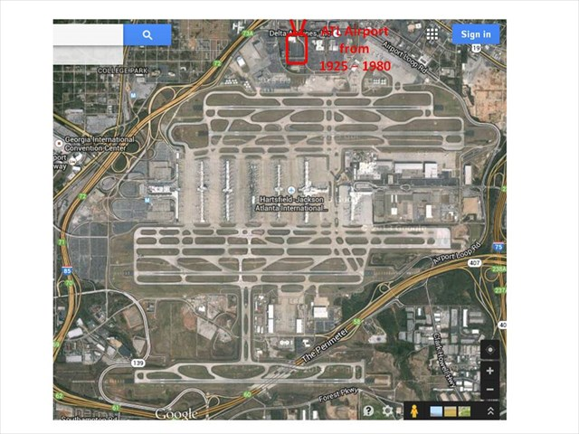
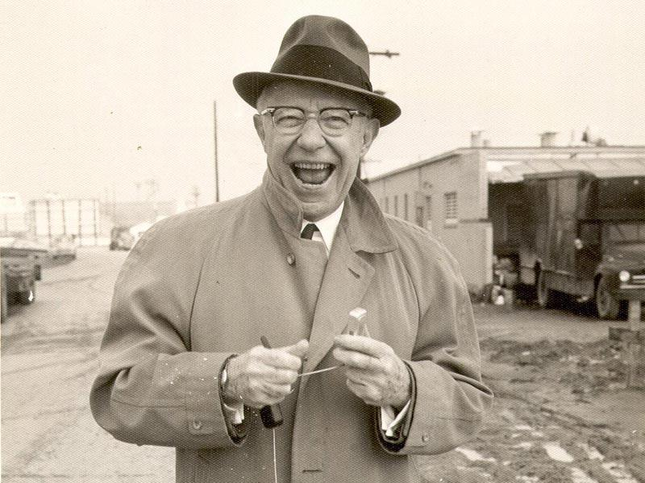
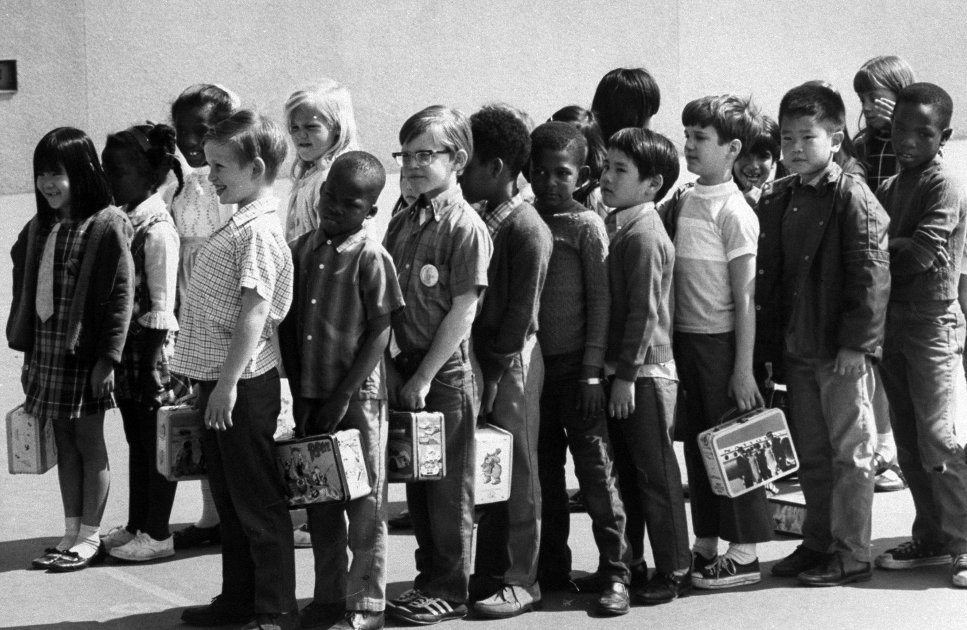
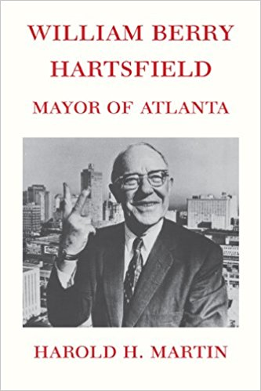
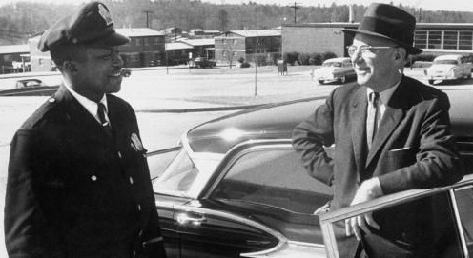
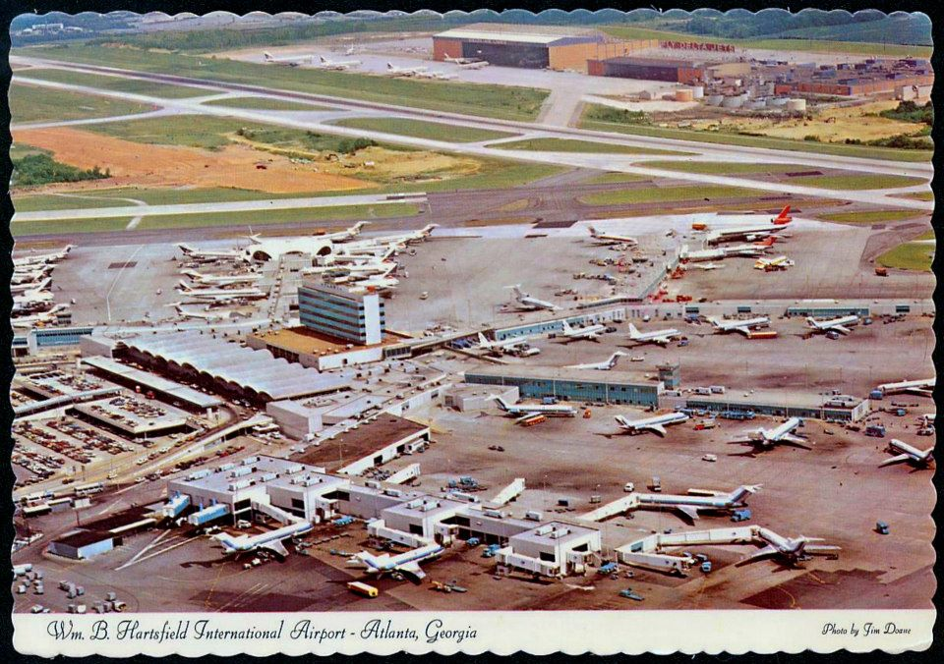
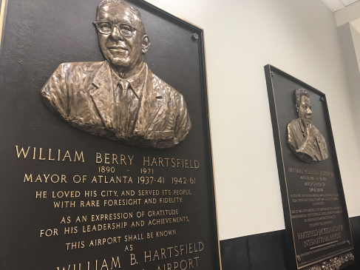
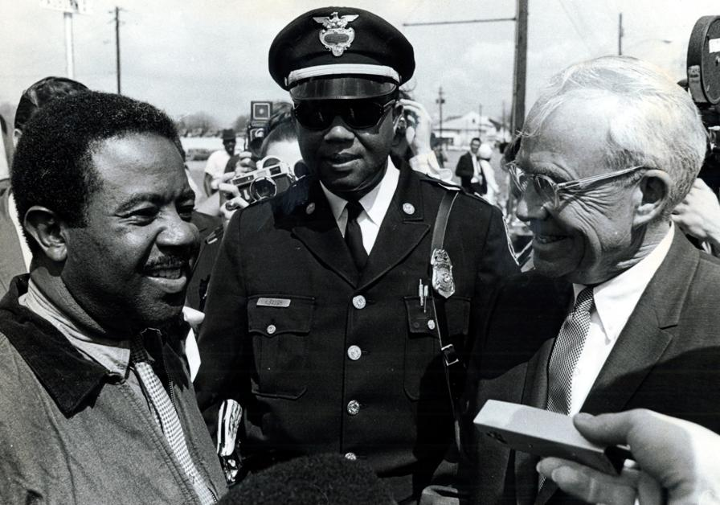
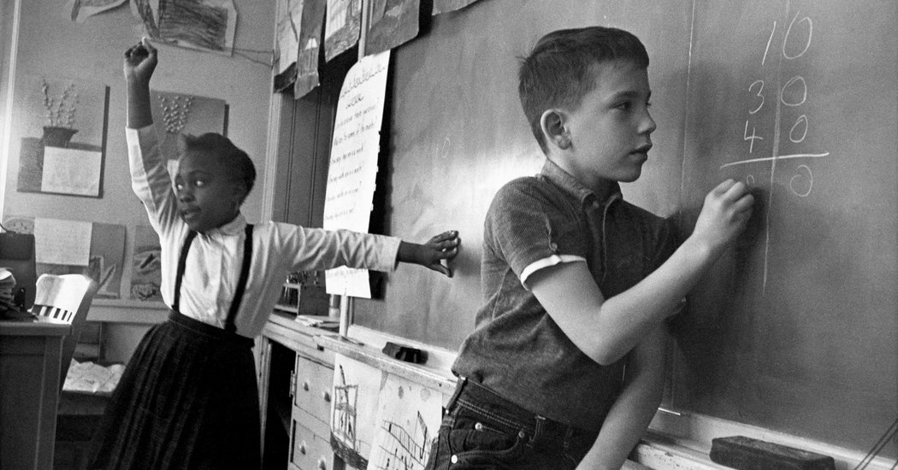

Slide 4
William Hartsfield: Father of Aviation
Georgia’s longest serving mayor
(1937-1941; 1942-1961)
Supported Civil Rights
City Council
Supported Aviation
1925 helped open Atlanta’s first airport
1941 Atlanta Municipal Airport
Integrated Public Schools as mayor

Slide 5
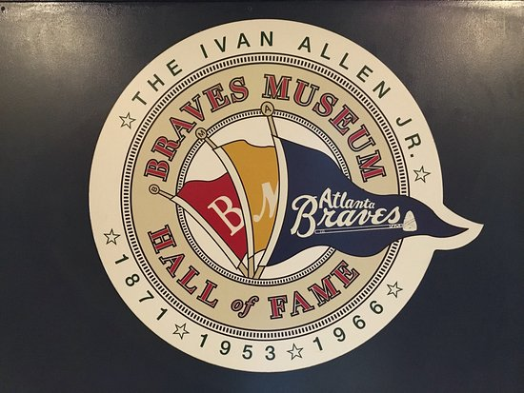
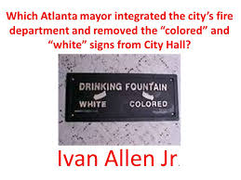
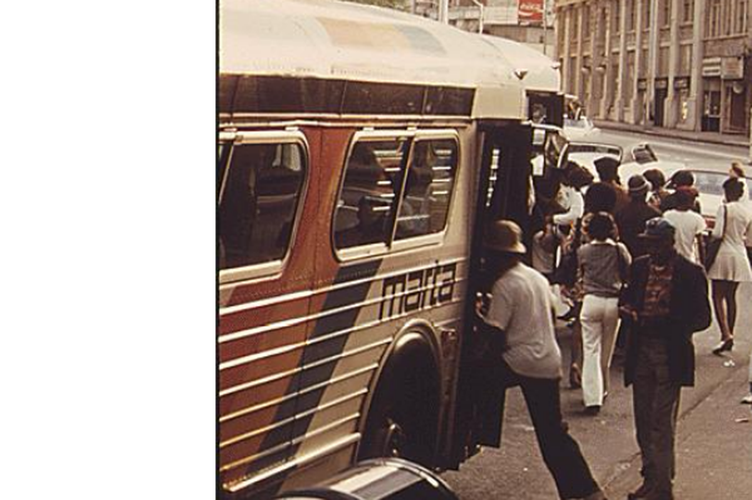
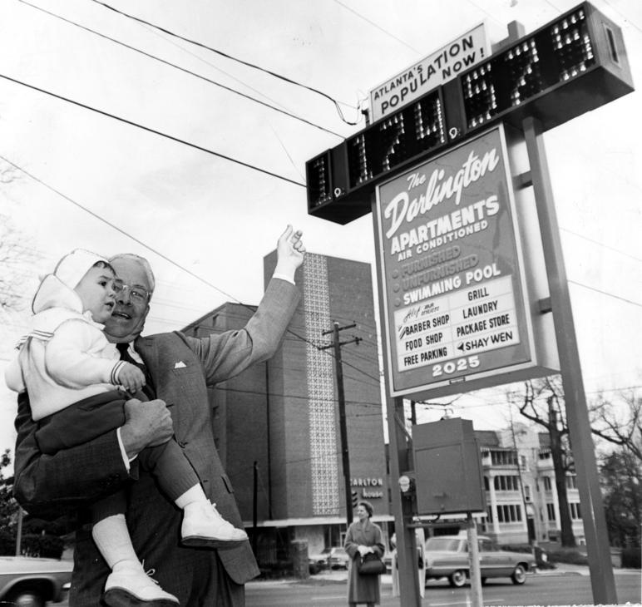
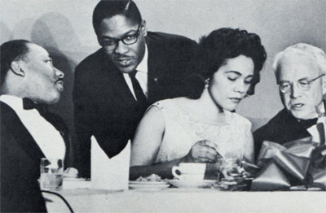
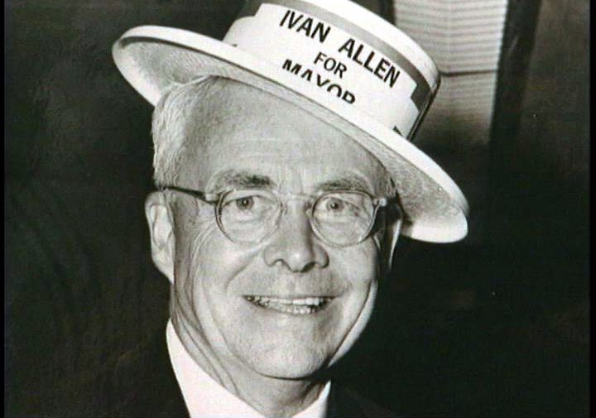
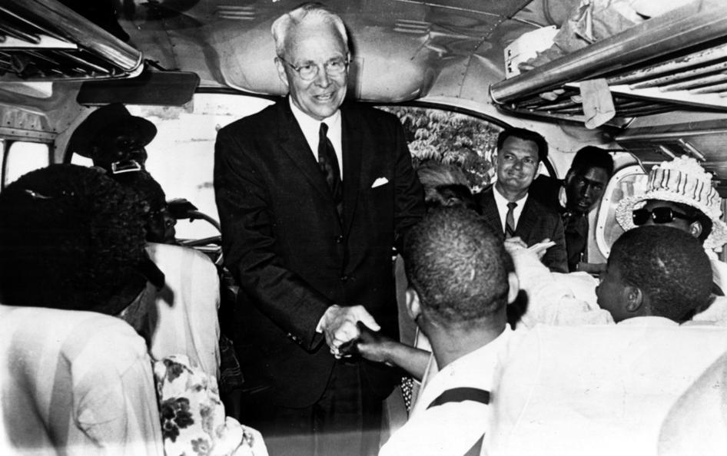

Slide 6
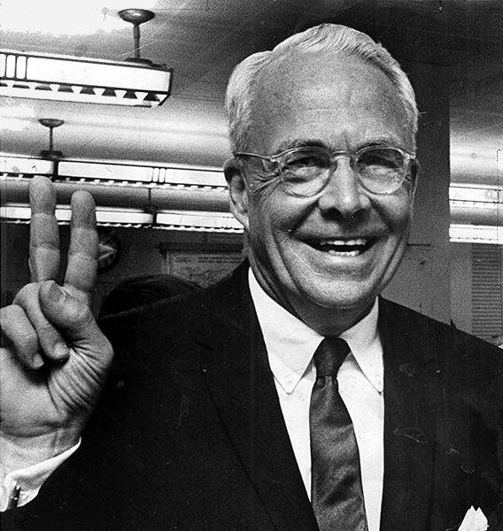
Ivan Allen JR
Georgia Mayor
First thing he did was remove all the “colored” and “white” signs from the building
Bigger supporter of Civil Rights
Desegregated building cafeteria
Worked with MLK
Helped create I-285
Helped start the M.A.R.T.A.
Major sports leagues in Atlanta
Hawks, Falcons, Braves
Had stadiums built

Slide 7
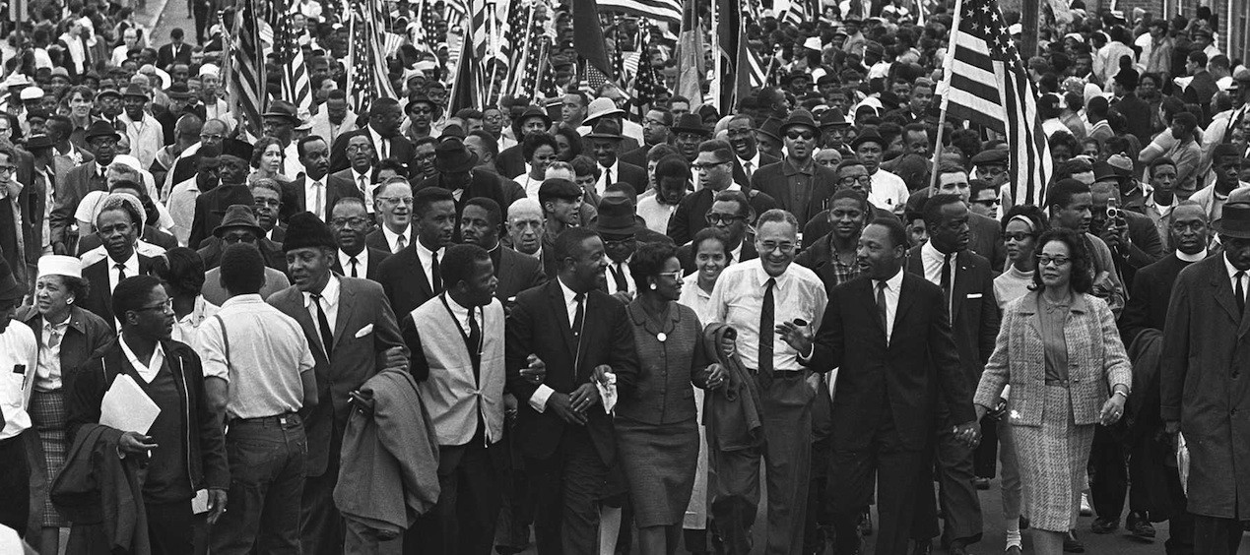
In the 1940s and 1950s, what were African Americans fighting for?
Notes:
This slide starts the OneSheet questions (#1)

Slide 8
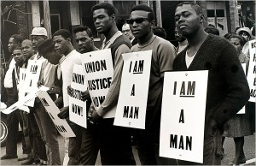
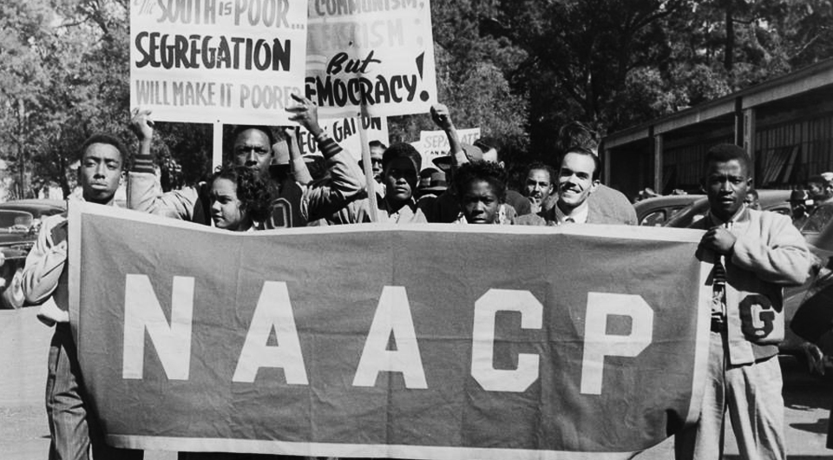
What group fought against segregation?
Review: Who created this group?
Notes:
#2 and a review
--WEB Dubois created it

Slide 9
Civil Rights leaders used what method to fight segregation during this time period?
Do you know any other ways people fought against inequality?
Notes:
#3
--after the second question, go to the next slide and see if students know the difference between the types of protests. You will need uno cards.

Slide 10
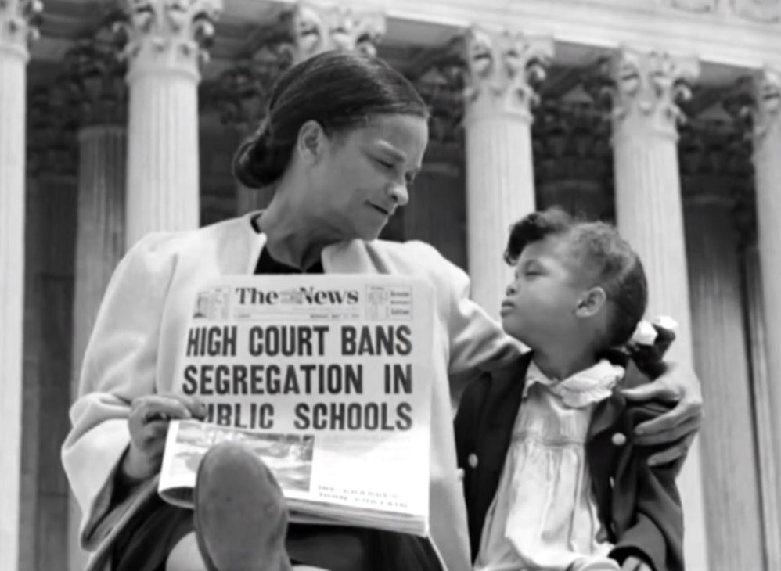
http://www.nbclearn.com/finishing-the-dream/1954-separate-is-not-equal/cuecard/1288
Brown v Board of Education
Decision?
Why?
Georgia’s reaction?
Notes:
#4, 5, 6
Video link at top of page (3ish minutes)

Slide 11
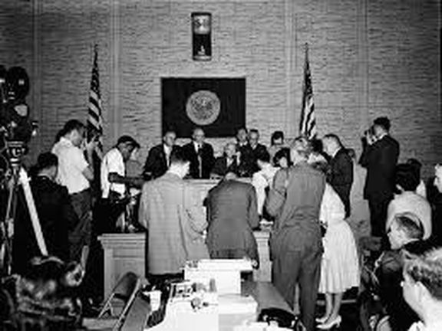
Sibley Commission
Describe.
Decision?
Event that changed minds?
Notes:
#7, 8, 9

Slide 12
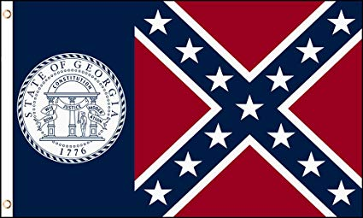
Georgia’s Flags
How did legislators show they did not support the
B v BOE decision?
How many times?
Barnes flag?
Current Georgia flag when?
Notes:
#10, 11, 12, 13

Slide 13
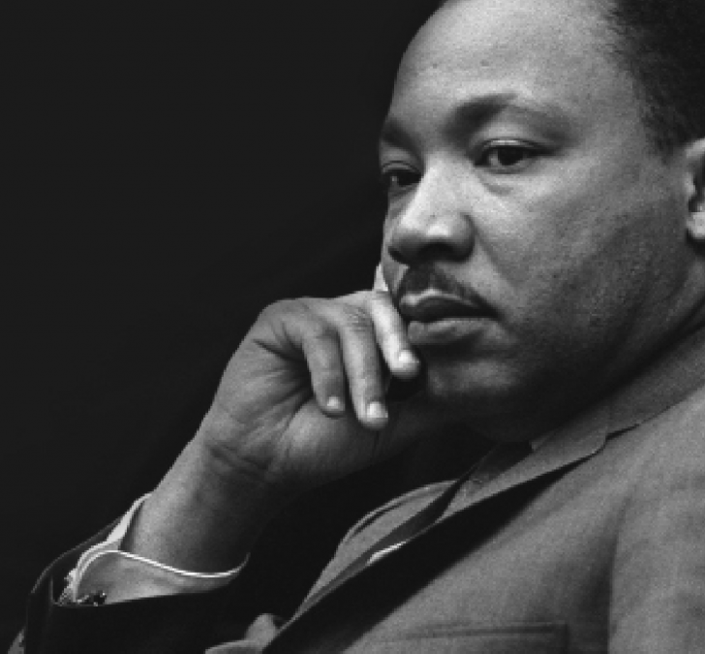
Martin Luther King JR
Method of equality?
Personal History? (3)
Spokesperson for?
Award?
Remembrance?
Notes:
#14-18

Slide 14
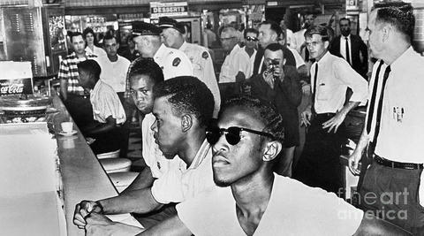
John Lewis
2 major events?
“Bloody Sunday”?
US Congress?
Notes:
#19-21

Slide 15
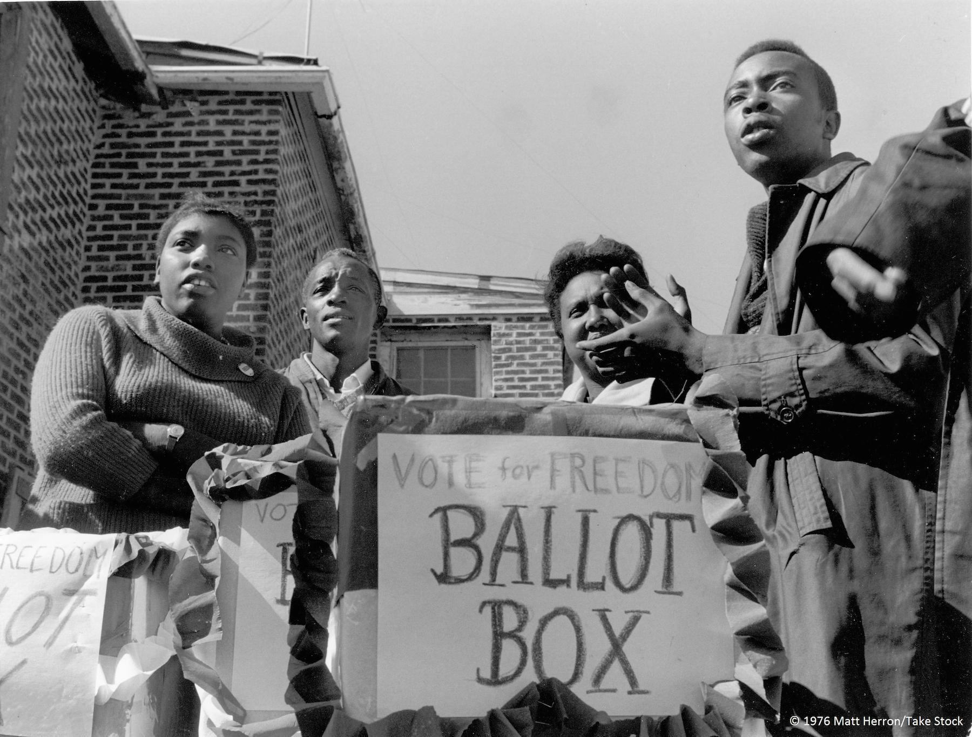
SNCC
Describe.
Events?
Break-up?

Slide 16
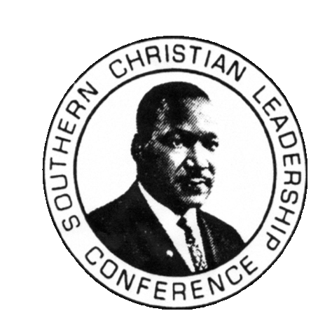
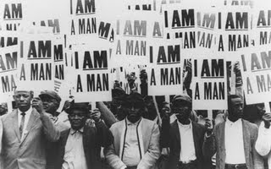
SCLC
Why?
Events?
Years active?
Today?

Slide 17
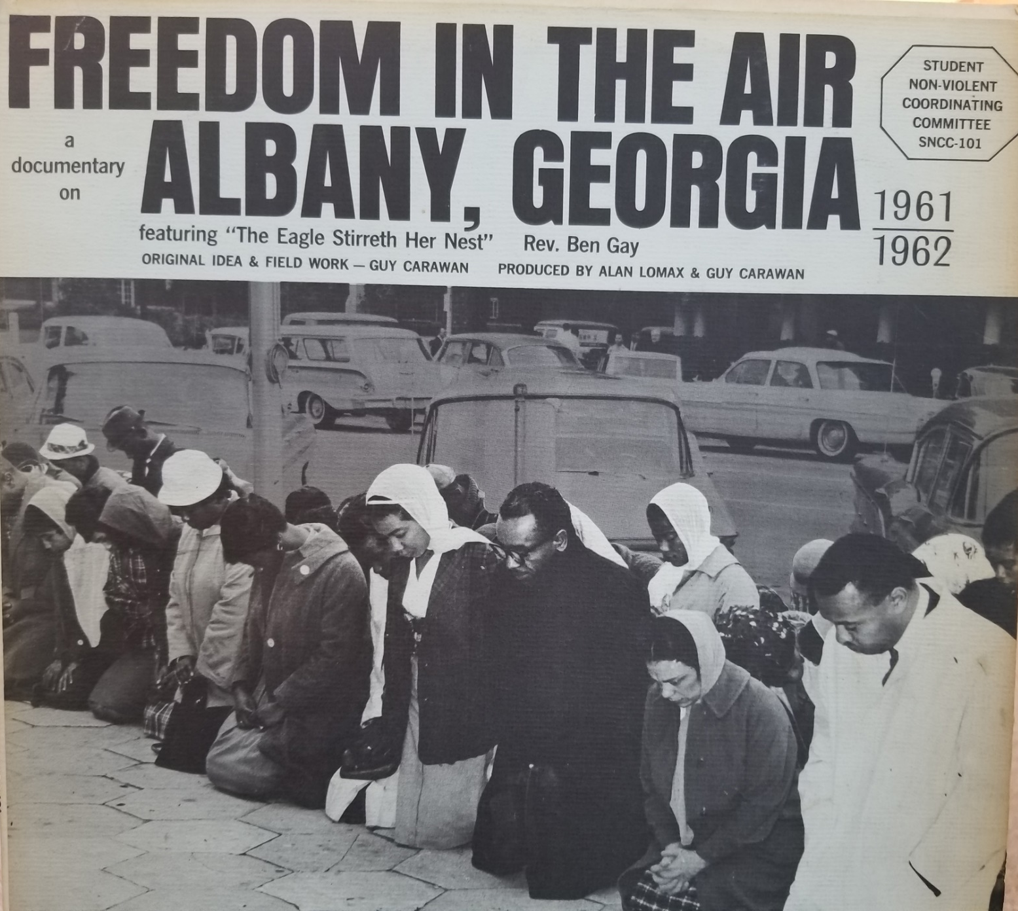
Albany Movement
GPB albany movement
Where?
goal?
How to obtain goal?
Who was involved?
Why did it fail?
MLK used it how?
Notes:
#29-34
There is a video in the top (5ish minutes)

Slide 18
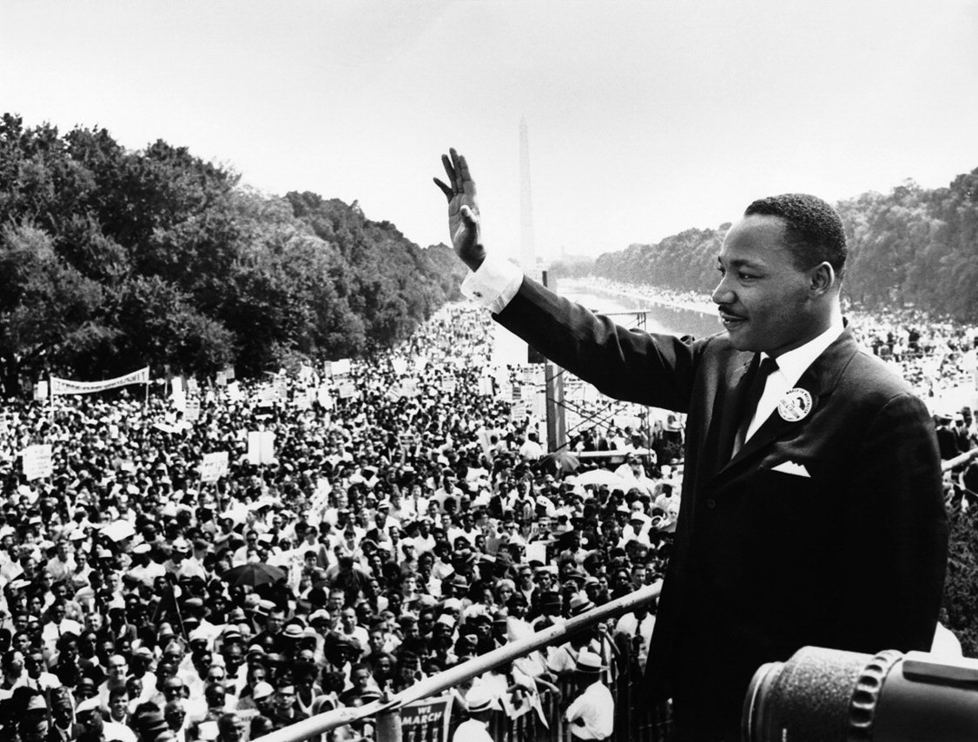
March on Washington
Describe.
Famous event?
Result?

Slide 19
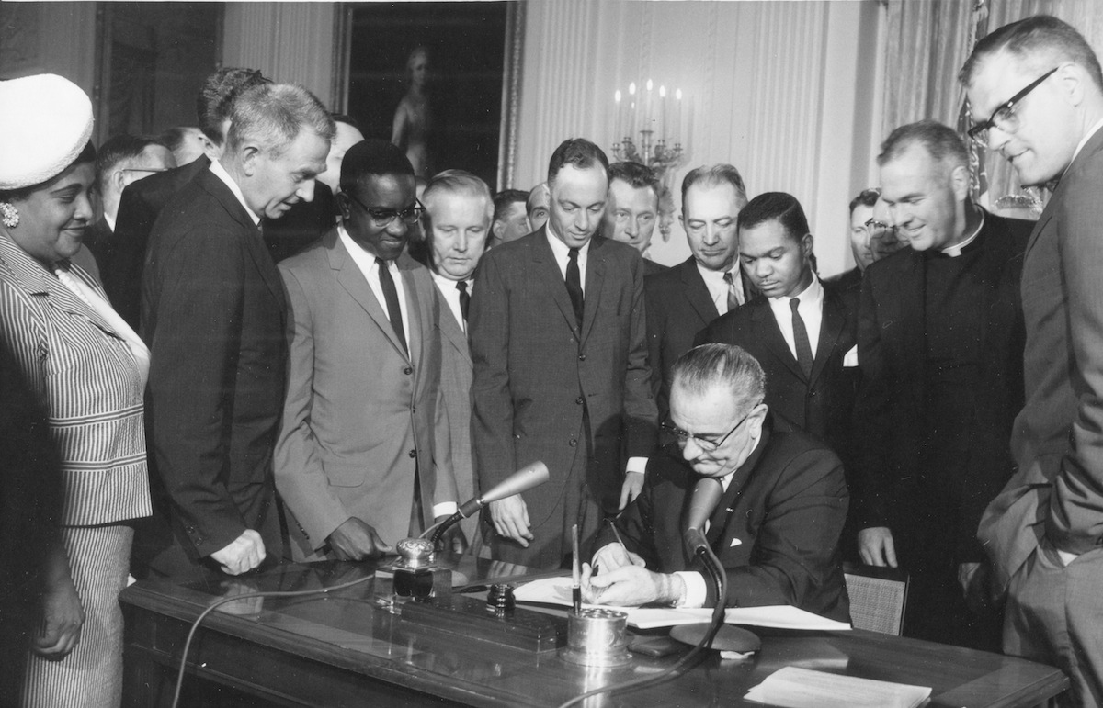
Civil Rights Act of 1964
Notes:
#38

Slide 20
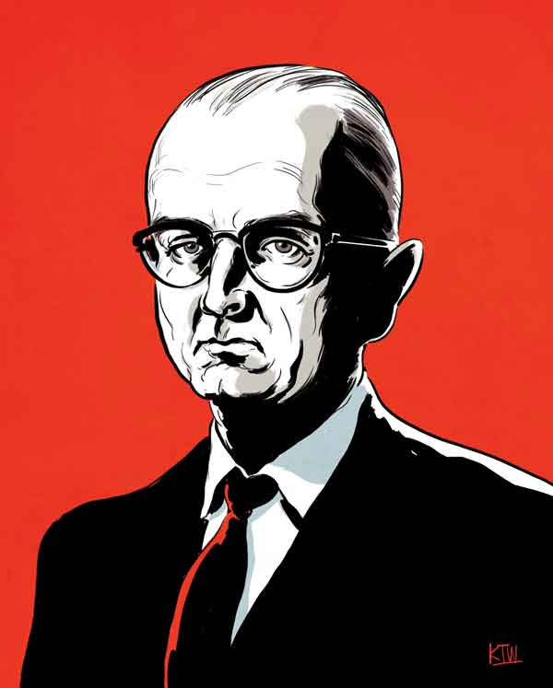
LESTER
MADDOX

Slide 21
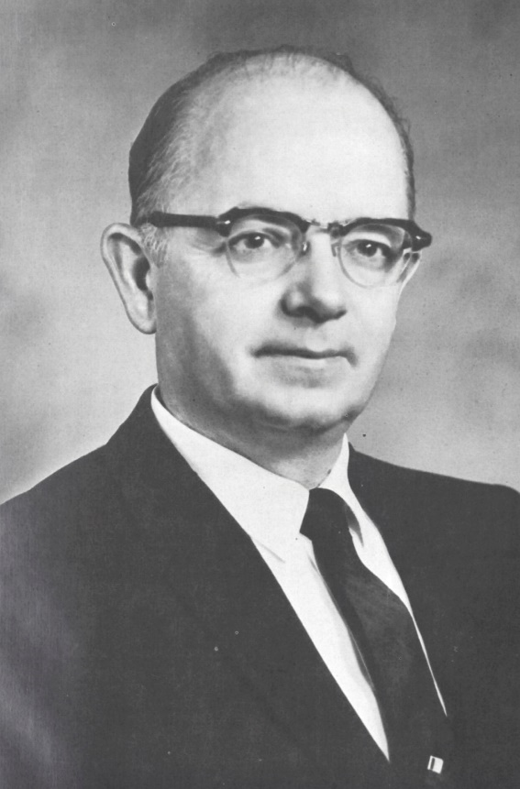
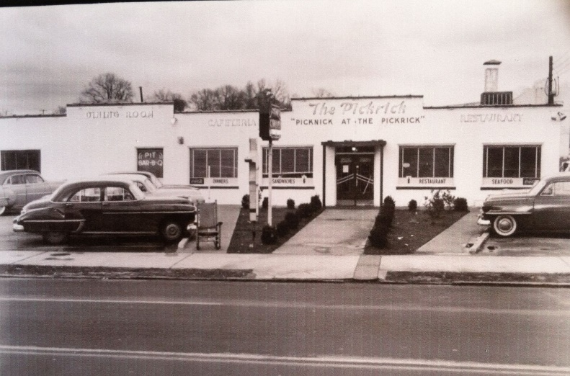
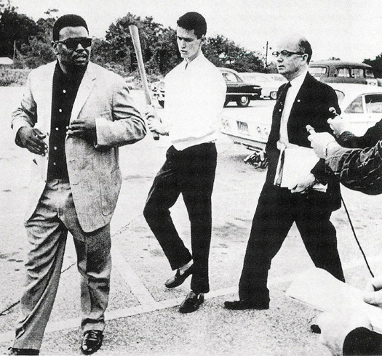
Lester Maddox (1913-2003):
Georgia’s last segregationist Governor
Defiant and outspoken against the Civil Rights Act of 1964
Opened the Pickrick cafeteria
Forced African Americans to leave his café with “drumsticks” axe handles
Closed the Pickrick instead of integrating it
Appointed more African Americans to government positions than all other governors combined (controversial)
Refused to fly flags at half staff for MLK’s death
Tried to stay in politics, but lost
Never apologized for his stance on Segregation

