Slide 1
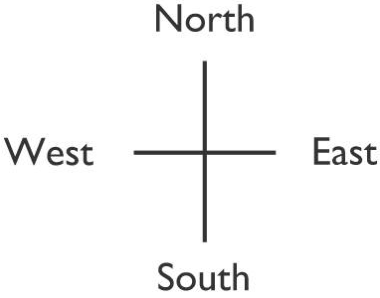
Georgia Geography
On a GLOBE, Georgia is located in 2 hemispheres
Northern and Western

Slide 2
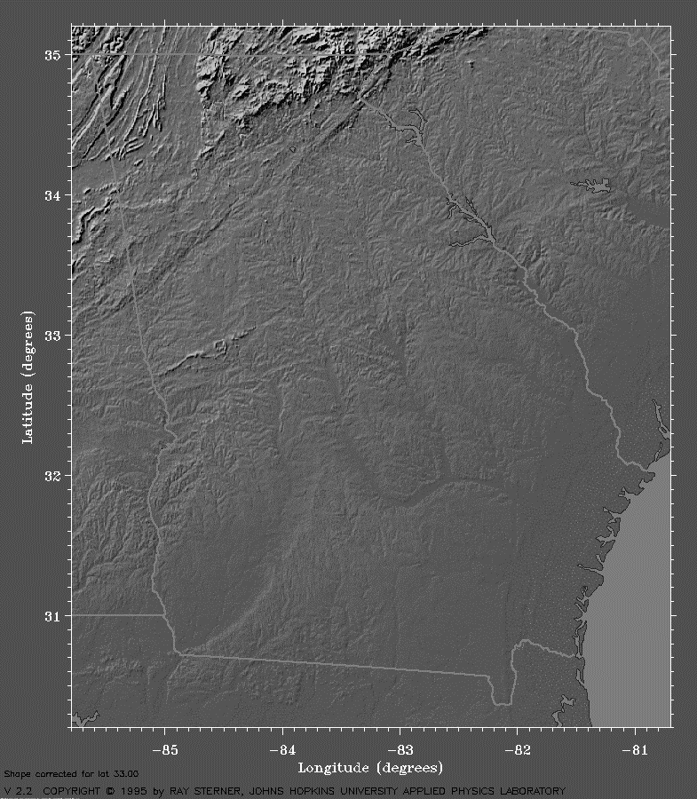
Georgia Geography
The southern part of Georgia is smooth and flat.
The northeastern part of Georgia is rough and mountainous
In the UNITED states, Georgia is in the South east region.

Slide 3
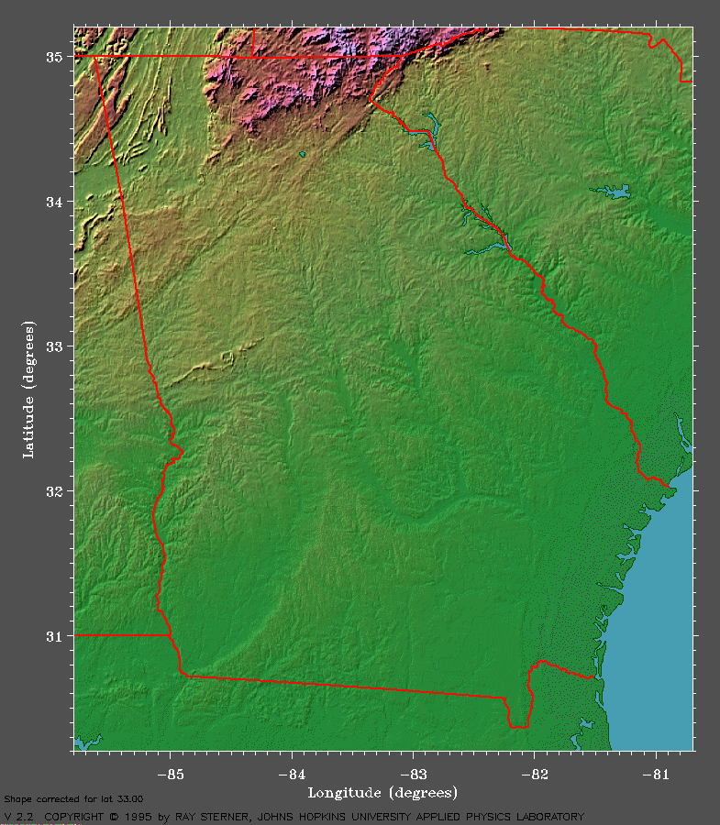
Georgia Geography

Slide 4
Georgia Geography
Flip your OneSheet to the back chart to fill in about the regions.
Georgia is divided into 5 Physiographic Regions: Coastal Plain, Piedmont, Blue Ridge, Valley and Ridge, and Appalachian Plateau.
Each of these regions differ from each other in location, size, population, climate, resources, and numerous other areas.
Georgia, overall, has a humid-subtropical climate.

Slide 6
Appalachian Plateau
Nicknames:
“TAG” Corner: Tennessee, Alabama & Georgia
Flat, gently sloping, sits above surrounding valleys
Soil composition:
Sandy soil not good for farming (soybeans)
Hardwood Forests (make the most money)
Only major coal deposits in Georgia
Lookout Mountain
Caving: popular pastime

Slide 7
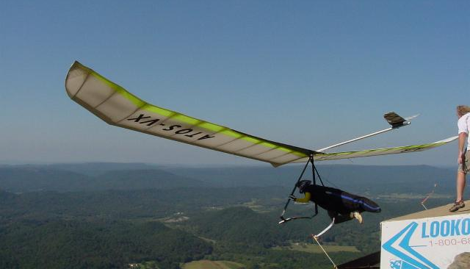
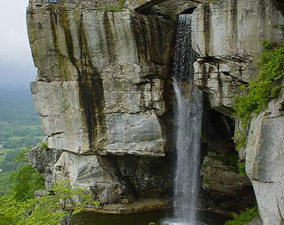
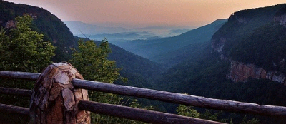
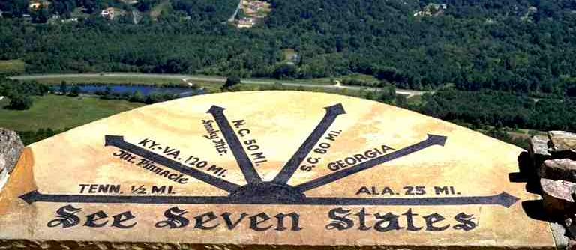
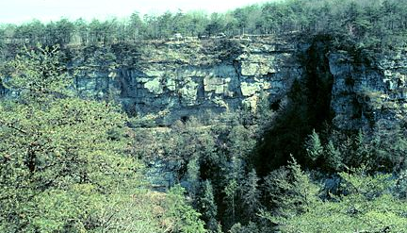

Slide 9
Ridge and Valley
Made up of narrow ridges & valleys: parallel
Mostly forests (orchards) & pastures (cows)
Best apples in Georgia
Dalton, GA: “the carpet capital of the world!”

Slide 11
Blue Ridge Region
Northeastern part of state
Contains state’s highest and largest group of mountains
Brasstown Bald, Georgia highest mountain (4,786 feet above seal level) is located here
Highest amount of precipitation
The mountains block the clouds from the Gulf of Mexico
Tourism brings in the most money in this region.
Hardwood forests, vegetable farming, and apples
Source of the Savannah and Chattahoochee Rivers

Slide 13
Piedmont Region
Begins in mountain foothills (bottom) and goes to central Georgia (us)
Contains many of the large cities of Georgia (Atlanta, Marietta) and most of the state’s population.
Gently sloping hills in north, flatlands in the south
Hardwood timber, pine, and agriculture (cotton, soybeans, animals)
Chattahoochee, Flint, Ocmulgee, and Oconee rivers
“Piedmont” means “foot of the mountains”

Slide 15
Coastal Plain Region
Largest region, three-fifths of state (60%) 100 miles of coastline
state’s major agriculture region (peanuts, peaches, coybeans, cotton, onions, pecans)
Deep water ports contribute economically connecting Georgia globally.
Low-lying freshwater wetlands (including the Okefenokee Swamp) are located in the southern portion of the state.

Slide 16
Georgia Geography
Flip your OneSheet to the front to begin seminar on features of GA.
There are 6 main physical features of Georgia.
The Fall Line
The Okefenokee Swamp
The Appalachian Mountains
The Chattahoochee River
The Savannah River
The Barrier Islands

Slide 17
Fall Line
Located where the hilly or mountainous lands of the Piedmont region meet the coastal plain region.
Runs from Columbus (west) through Macon to Augusta (east)
Many waterfalls caused by water from the hills cutting channels into the softer soil of the plains
Fall Line waterfalls provide power source for several Georgia communities
HYDROELECTRIC POWER!

Slide 18
Okefenokee Swamp
Largest swamp in North America (681 square miles)
Freshwater (not salt water) wetland
Home to more than 400 species of animals
Protected by the Federal Government
Water lies close to the surface
President Franklin D. Roosevelt created the Okefenokee National Wildlife Refuge which protected land and stopped logging companies from cutting down the large, old trees.

Slide 19
Appalachian Mountains
Very large mountain range which runs over 1,500 miles from eastern Canada to central Alabama.
The southernmost part of the Appalachian Mountain chain is called the Blue Ridge Mountains. Located in the Blue Ridge, Appalachian Plateau, and Ridge and Valley regions.
Close to 100 miles of the Blue Ridge Mountains extend into north Georgia. These areas are known for beauty and attract many tourists.
These mountains form the first barrier to warm, moist air from the Gulf of MexicoThis precipitation forms the basis of many of Georgia’s rivers.

Slide 20
Chattahoochee River
Begins in the Blue Ridge Region and flows southwest toward Alabama and into the Gulf of Mexico.
The river is a fast moving creek north of the Fall Line and can not be used for boat travel most of the year. The river flattens out and slows down south of the Fall Line and can be used for transportation.
Indians used the river as a food and water source.
Provides most of the drinking water for the metropolitan Atlanta area.

Slide 21
Savannah River
Natural boundary between Georgia and South Carolina.
Empties in the Atlantic Ocean.
Also used as a source for hydroelectric power.
Provides most of the drinking water for Augusta and Savannah.
Savannah Port is important for international trade and business (Shipping imports and exports)

Slide 22
Barrier Islands
Form a barrier between Georgia’s mainland coast and the Atlantic Ocean.
Helps to protect Georgia’s mainland coast form strong winds, waves and ocean currents.
Important to the state’s tourism. Many people visit the beaches and resorts
Wildlife refuges, some are developed (tourists), some are privately owned

Slide 23
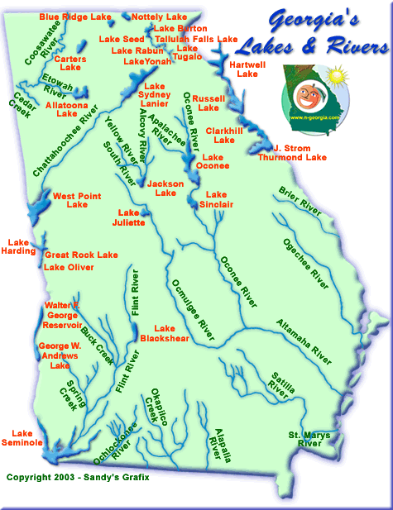
Waterways impact economy
Indians use rivers for food, transportation, and trade (economics)
After colonization, settlers used rivers for a source of water for crops and farming.
Control of waterways during the Civil War determined success
Reservoirs used for flood control, hydroelectricity, and recreation.
Later in history, rivers and lakes were used for power and recreation.
Today used for imports and exports.

